Slide 1
Community Driver
Mentor Programme

Slide 2
Welcome
• Introductions
- Partners
<list them here>
- Mentors
• Special thank you to mentors

Slide 3
Programme objectives
Learner drivers need experience to drive safely and to pass their tests. The purpose of the Community Driver Mentor Programme is two-fold:
• To address issues of disadvantage for learner drivers in the 16–24 age group seeking to get their restricted licences, such as access to suitable vehicles, mentors and practice
• To improve levels of safe driving for these learner drivers

Slide 4
Learning to drive is a major turning point in young people’s lives.
> Employment
> Safety/knowledge
> Freedom/opportunities
> Pride in driving well
Some of the young people are missing out through a lack of suitable driving mentors/supervisors and/or vehicles

Slide 5
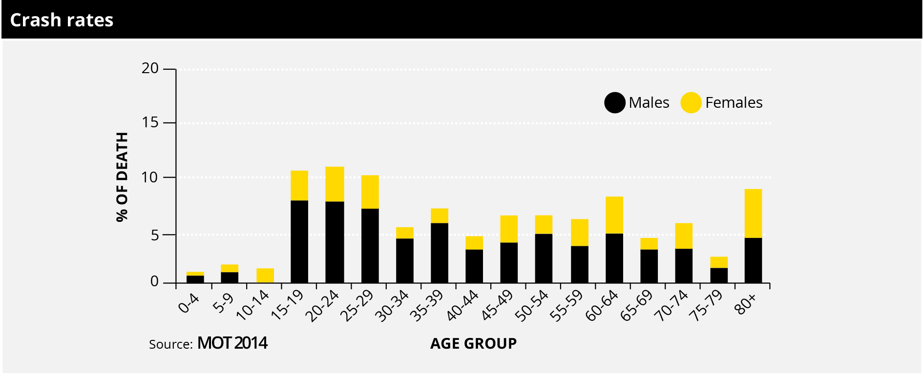
NZ statistics:
Reasons why every new driver needs driver education and experience

Slide 6
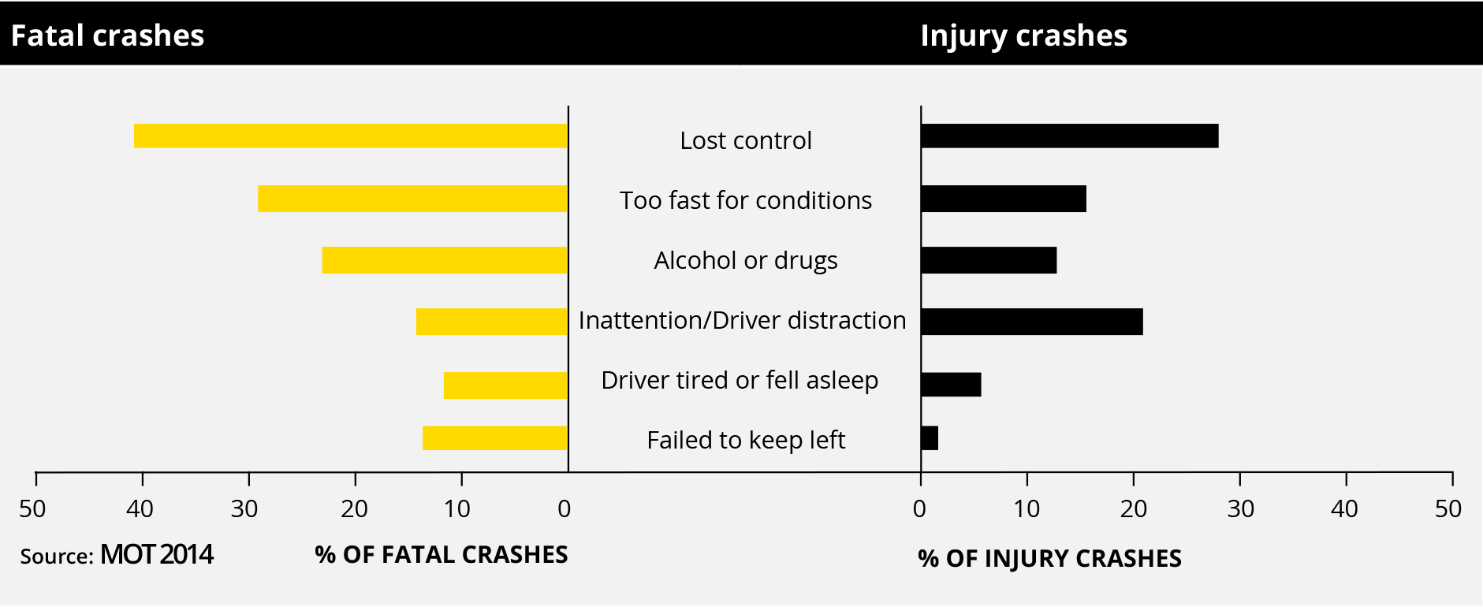
NZ statistics:
Causes of Fatal Crashes

Slide 7
Driving is much more than ‘car control’
• Learning to use a vehicle is the simple part of this complex task
• Learning to drive well/safely with all other road users is more difficult
• The attitude and experience of the driver is critical for overall driver competence
• Resource support:
Road code/www.practice.co.nz

Slide 8
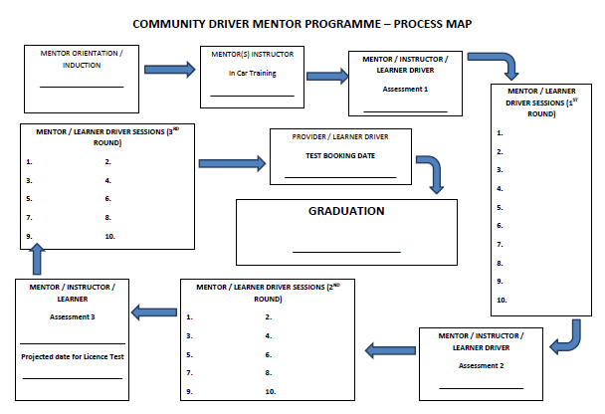

Slide 9
The Role of the Mentor…
“Mentoring primarily involves encouragement, listening with empathy, sharing experiences and developing insight while acting as a sounding board” NZ INSTITUTE OF MANAGEMENT
Personal Attributes of the Mentor...
Approachable/ friendly/ credible/ trustworthy/ honesty/ role model/ able to problem solve/ good listening skills/ able to provide constructive feedback/ has sound road code knowledge/ can describe and demonstrate sound driving skills

Slide 10
The Roles & Responsibilities of the Four Stakeholders
Community Provider
• manages all appointments for all stakeholders
• will hold all documentation for the programme
• provides the vehicle for all mentoring lessons
• is the first point of contact for any issues

Slide 11
The Roles & Responsibilities of the Four Stakeholders
Learner Driver
• attends all driving sessions on time
• personally manages their progress
• takes every opportunity to learn
• progresses to achieve their restricted licence test standard

Slide 12
The Roles & Responsibilities of the Four Stakeholders
Mentor
• attends driving sessions to achieve progress that develops the learner to the restricted test standard
• tailors the lesson to suit the learning style of the driver
• sets progress goals with the learner at each session
• supports the learner through all manual/ visual/ cognitive learning
• provides as much resource support as possible
• encourages the learner to maintain momentum/progress

Slide 13
The Roles & Responsibilities of the Four Stakeholders
Driving Instructor
• provides initial driving assessment/coaching (plus two more)
• scopes the driving skill task platform for the mentor/learner to follow
• provides professional expertise/ insight to both mentor/learner during the three driving lessons

Slide 14
Coaching and supporting the learning process
• choice of words (for clarity yes/no)
• resources – road code/diagrams/demonstration of manoeuvre
• vary the practice dependant on skill level (open road/motorway/ roads with pedestrians/cyclists/roadworks
• self evaluation techniques: encouragement to develop safe attitudes/honest feedback to develop self awareness
• young brains are still growing: The part (frontal lobe) of the brain that deals with risk and impulse control does not fully develop until mid-20’s

Slide 15
The paperwork… Critical to mentor role
• log book documentation (hand out)
• pre-planning before the drive to structure the mentor session to include the driving instructors requirements
• completion of notes, progress achieved
• feedback from the learner driver
• agree the goal for the next lesson
• feedback to the office
• set up next drive: time/date
• any issues to be escalated to the staff at the office

Slide 16
Enjoy the process… and relax in your role
Two main areas vital to safe driving
• the ability to detect hazards and risks
• self assessment by the learner driver of their driving performance

Slide 17
Next steps
• Matching of learner drivers, driving instructors and mentors
• The first driving ‘lesson’
• Developing your mentor driving plan
• Record keeping (log books)
• Ground rules and escalating issues
• Key contacts

Slide 18
Resources to help with your journey
• Current copy of NZ Road Code
• Restricted Licence Test Guide - http://www.nzta.govt.nz/assets/Driver-Licences/docs/restricted-test-guide.pdf
• Instructional videos covering driving skills and test requirements https://www.youtube.com/channel/UC0_2ANS8zsc-J-RoKK7VxYg

Slide 19
Questions?

