Slide 1
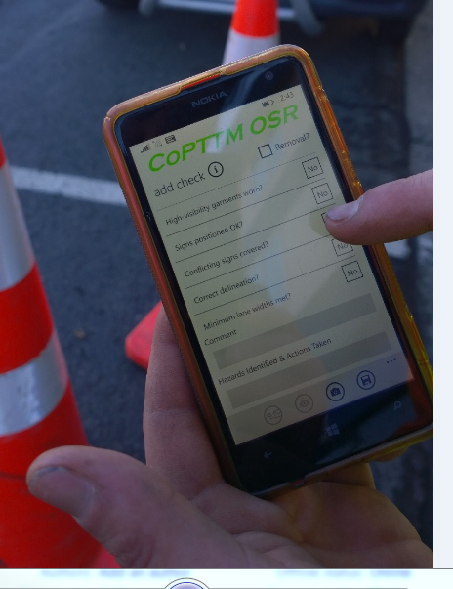
On-Site Record APP
Designed for your smart phone

Slide 2
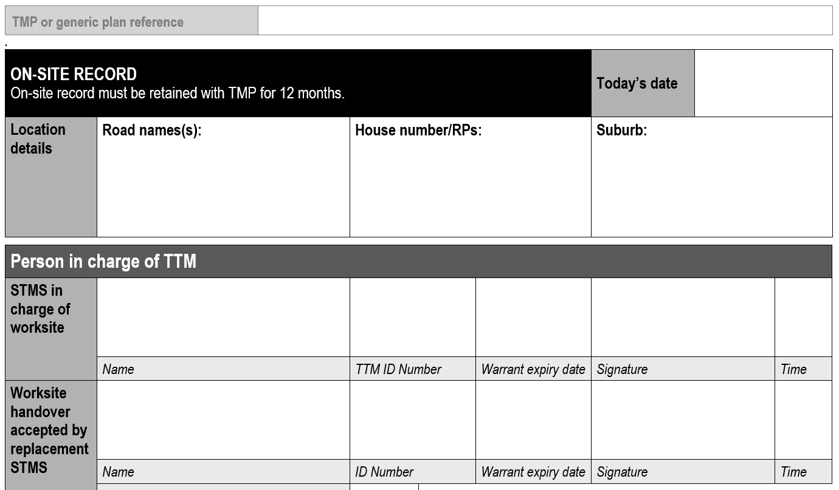
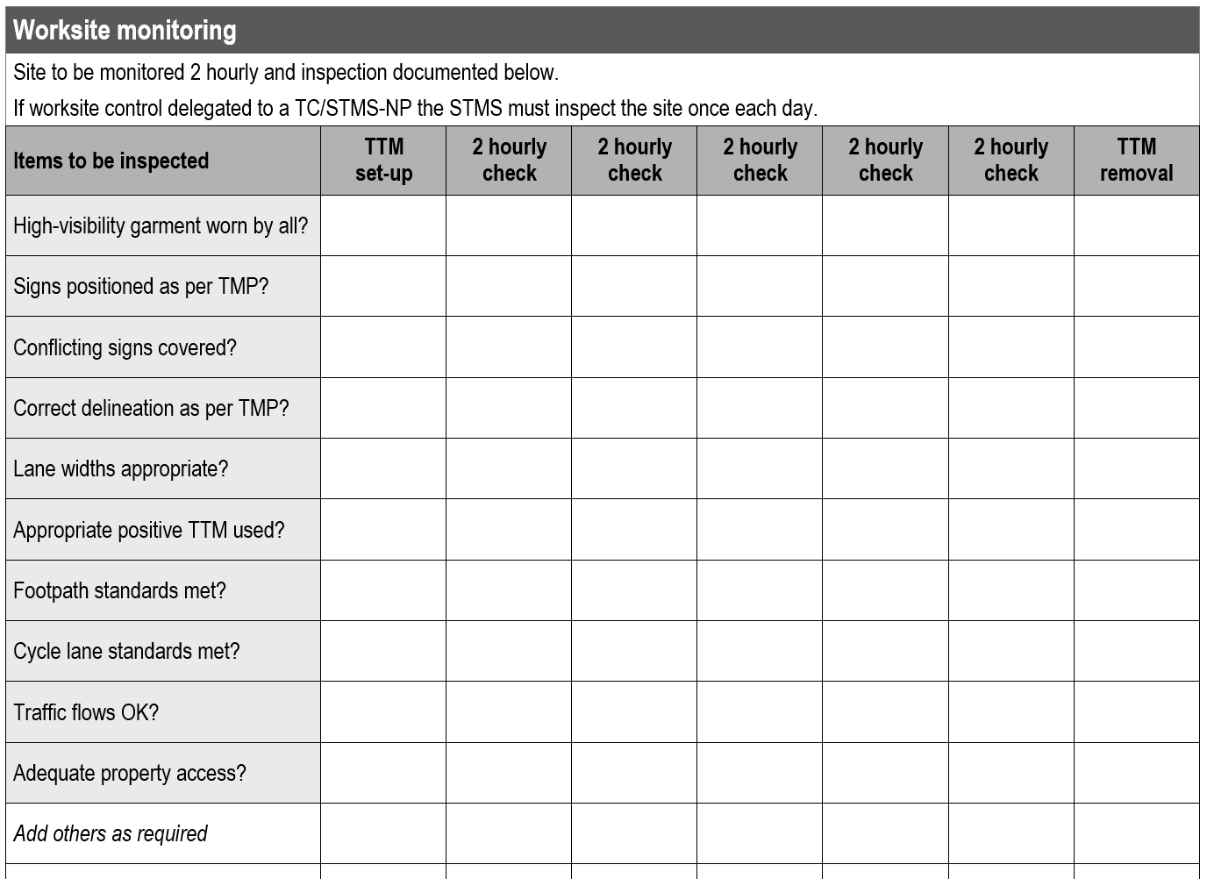
On-Site Record - Paper Form
TRAFFIC MANAGEMENT & CONTROL Ltd

Slide 3
Electronic alternative that mirrors the CoPTTM On-Site Record
- Windows APP (finished)
(Plus a small update released in 2 weeks to reflect new changes of the site hand over NZTA have made)
- Apple APP (75% complete, released August 2015)
- Android APP (released September 2015)
Created for smart phones to enable contractors to keep track of their temporary traffic management On-Site Record.
Using something that already exists in the modern day pocket and using its capabilities to streamline our daily requirements as a qualified TC/STMS.

Slide 4
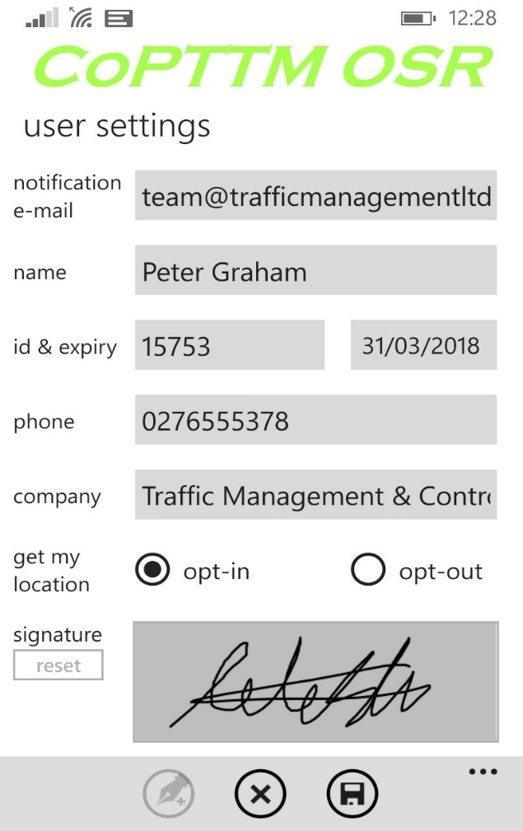
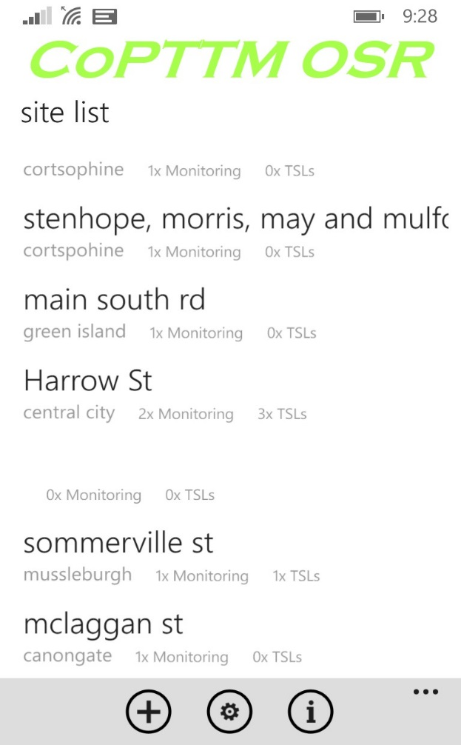
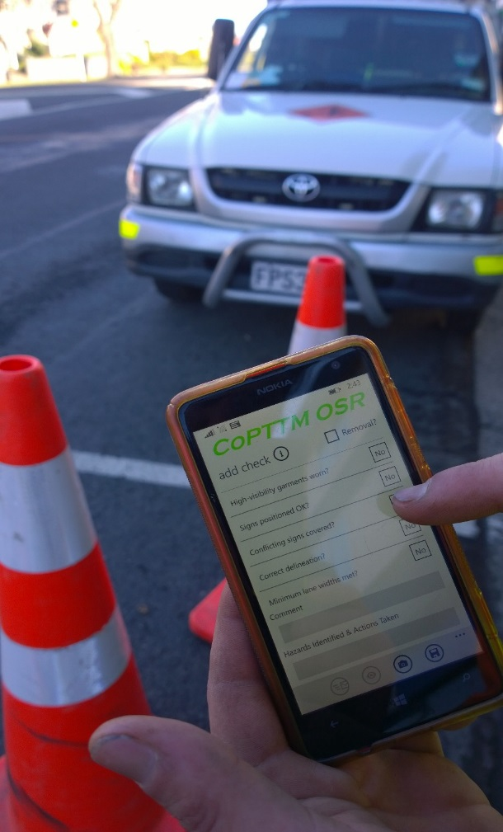
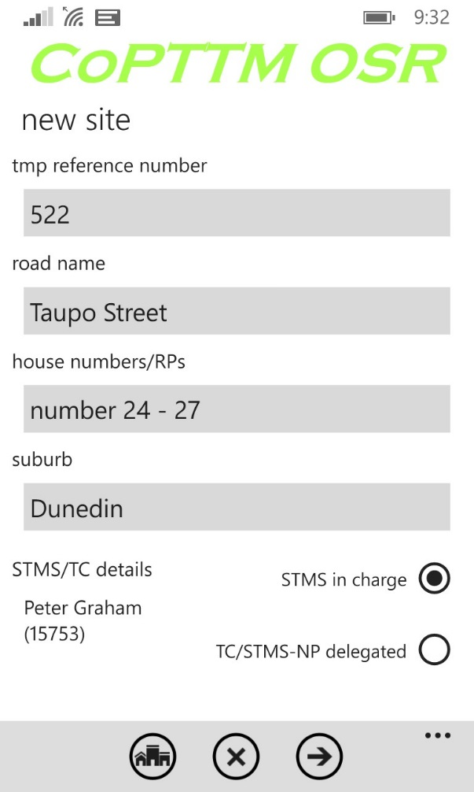
Using the OSR App – Example
User Settings
Site list (active sites)
On site
Creating a new site

Slide 5
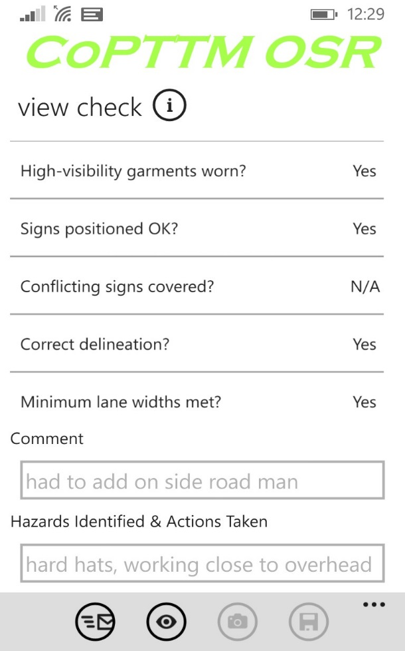
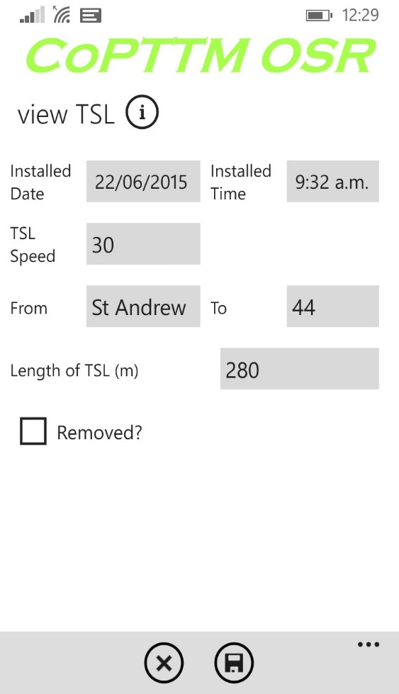
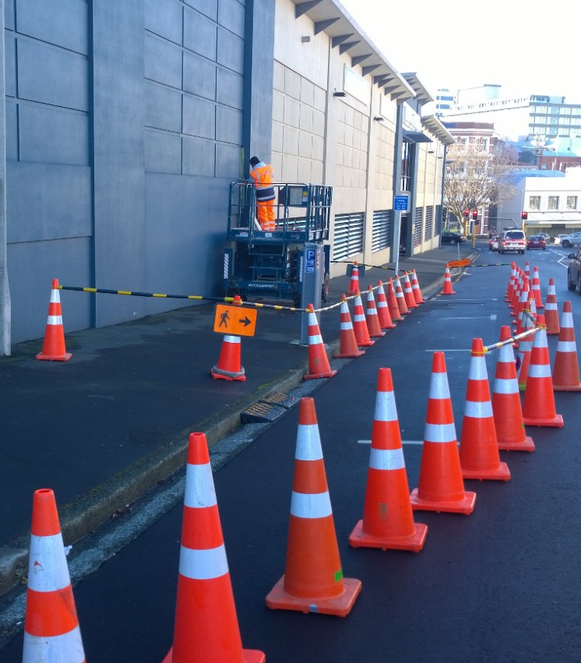
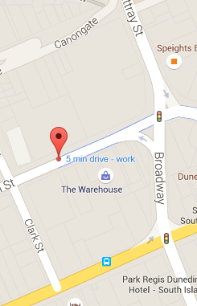
Monitoring (site checks)
Using the OSR App – example
TSL recorded
Site Pictures attached
GPS records location

Slide 6
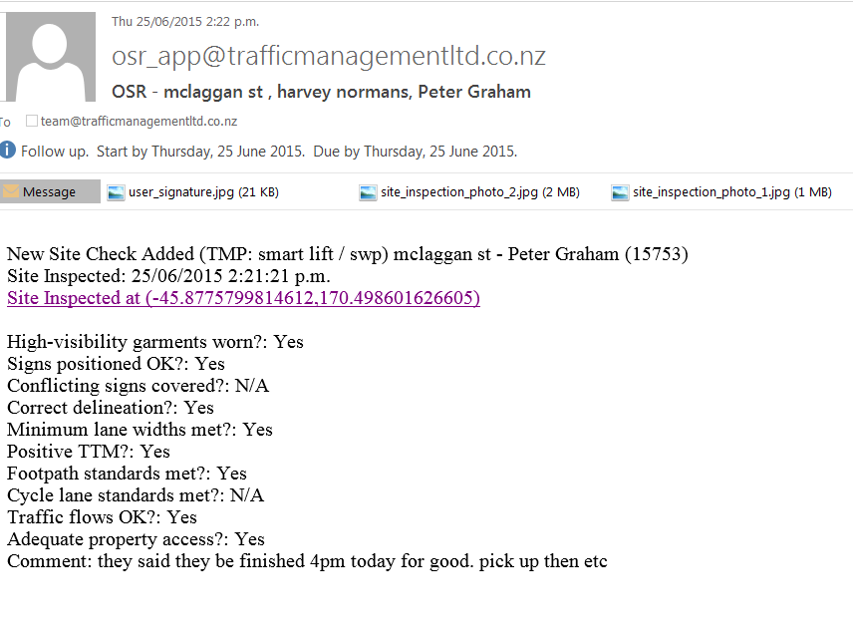
APP sends the OSR report to your designated email address. This could also be a forwarder that links in all your staff or even your RCA/Engineer if requested. Note dates & times are automatically generated at the time of each site check from your phone, reducing some fields that would have been filled in on the paper form. Checks can’t be undone/changed to ensure credible & accurate records.
Emailed Summary

Slide 7
Video – Going through the App process
Key words when searching in the APP Store
OSR
On-Site Record
CoPTTM

Slide 8
Benefits of using the On-Site Record App
Streamlining the process of record keeping, ensuring credible & accurate record keeping.
Quality Control: Ability to reuse site pictures for tool box briefings, site hand overs to new STMS and being able to forward site information via your phone. Having another set of eyes monitoring your TTM sites, keeping your entire team up to date with real time reporting.
Taking Site Recording to a new level: Enabling the STMS/Contractor to prove times and dates that each site check (OSR) was completed, pictures attached confirming actual site condition and certainty of where you were at the time of the OSR using the phones inbuilt GPS.
Connecting your staff: In the field to the office (personal phone to your office PC)
Effortless file keeping: No more scanning, printing & losing those hard copies and never short on a blank OSR again!
Site Hand Overs: Tracking who is in charge and the delegated TC onsite.

Slide 9
Example of Site Handover (released in next update)
TRAFFIC MANAGEMENT & CONTROL Ltd

