Slide 1
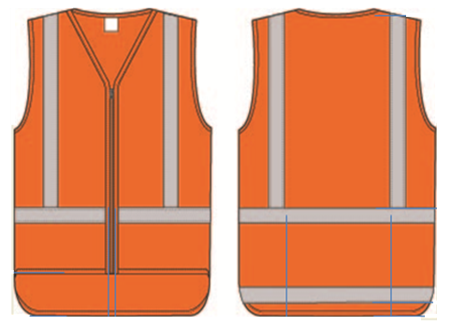
NZTA TTM Conference 2015 - Wairakei
High visibility garments

Slide 2
CoPTTM Section B3 High visibility garments
High Visibility Garments:
Highlight changes in 4th Edition
Section CoPTTM Effective 1 January 2015
where TTMC label became TTMC–W
Introduce:
A New design
For a Traffic Controllers (TC) Garment

Slide 3
CoPTTM Section B3 High visibility garments
A quick history
First High Visibility Garments made in NZ in the 90’s were
a New Zealand version of EN 471 design (for HCH).
In the late 90’s (‘97 & ‘99) the joint Aust & NZ Standards committee
published a Materials and a Garment Standard
- Early CoPTTM Designs based on these Standards
2010 and 2011 revisions were published for both these Standards.
2012 CoPTTM Section B3 updated to harmonise with the new Standards
A wider range of garment options were added to incorporate a number
of garments that had “appeared” in the market.
Garment design specifications established in conjunction with NZ’s
leading manufacturers

Slide 4
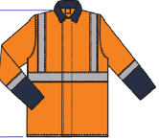
CoPTTM Section B3 High visibility garments
CoPTTM Section B3
High visibility garments
High visibility materials and retroreflective fabrics must comply with
AS/NZS 1906 Part 4 2010
Part 4 High visibility materials for safety garments
both Fluoro and non fluoro
including the 2014 amendment
Garment designs are harmonised with but add to
AS/NZS 4602 Part 1 2011
Part 1 Garments for high risk applications
including the pending amendment
Compliance certificates

Slide 5
CoPTTM Section B3 High visibility garments
High visibility garment design concept:
Each garment is appropriate for use:
in any weather condition, dry or rain
in daylight or the hours of darkness
and in low light conditions
The garment design specification:
CoPTTM Compliance set slightly higher than the minimum levels set in
Standards documents to recognise
the increased risk of accident
the frequent exposure to such risk and
the potential severity of the injury
Section B3 is a definitive design – not a minimum Standard

Slide 6
CoPTTM Section B3 High visibility garments
Critical compliance points: (known by manufacturers)
Sewn in Label must state TTMC-W Compliant – incl Xtra Small
sizes
Test for compliance is the Size “S” Small garment – all in design
range must then be graded in proportion up and down
Area of background material is calculated as specified in
AS/NZS 4602.1 but to the area specified in CoPTTM.
Configuration of strips must comply with figures in Section B3
All garment designs must comply with both the specification
and Figures in Section 3
Compliance date = 1st January 2015. Current garments are good until no
longer appropriate for purpose.

Slide 7
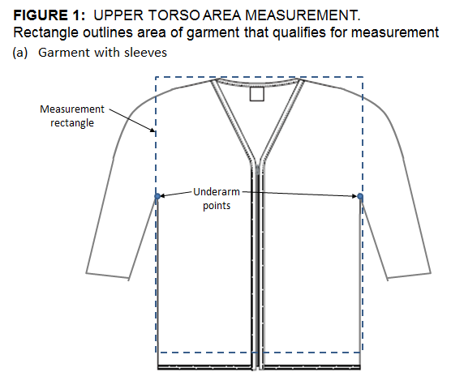
CoPTTM Section B3 High visibility garments
A point of note:
High Visibility Area Measurement
The International convention for high visibility measurement is the torso area only.
It does not include the sleeves area.
For high visibility garments the sleeves should morally maintain high visibility colour

Slide 8
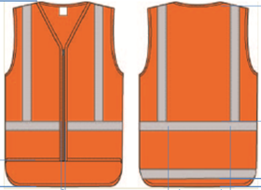
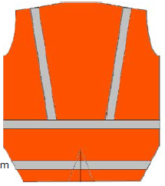
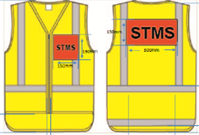
CoPTTM Section B3 High visibility garments
Original CoPTTM Concept
Original CoPTTM Concept – Changes from:
Last Garment on Vest style garment.
Area background fabric – 0.6m² Area retroreflective fabric – 0.2m²
Finished sleeveless vest garment forced to be too large for safety
To: (for compliance size “S”)
Front - fabric area 0.21m²
Rear - fabric area 0.27m²
Retroreflective - per configuration
(panels and Tape)
Company logo area remains
Shirt tail remains at 150mm

Slide 9
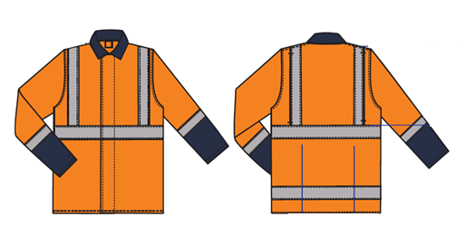
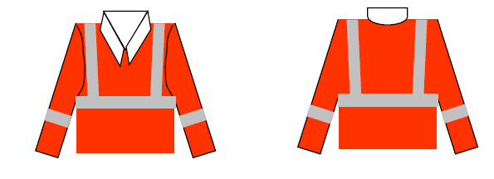
CoPTTM Section B3 High visibility garments
The Original Long Sleeved Garment
Becomes a Long Sleeved Coat
Now: (compliant “S” size)
Area remains at 0.6m² = 0.3m² front and back
Retroreflective configuration as indicated
Retroreflective additions permitted
Collar and sleeve colour

Slide 10
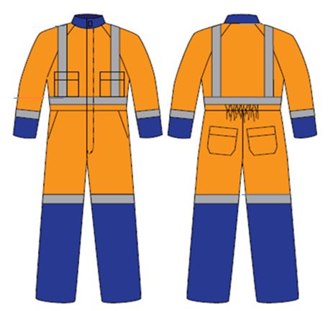
CoPTTM Section B3 High visibility garments
Overalls option introduced
New: (for compliant size “S”)
Area = 0.6m² = 3m² front and back
Retroreflective configuration as indicated
Retroreflective additions permitted
Collar colour
and sleeve colour from below the elbow
Lower leg colour from a point above the knee

Slide 11
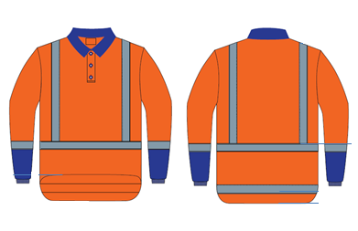
CoPTTM Section B3 High visibility garments
NEW Miscellaneous Garment option
New: for compliant small size
Area as for Sleeveless vest
0.21 & 0.27m²
Retroreflective as indicated with shirt tail
Short Sleeve must be Orange
Long Sleeves colour change from below the elbow
Retroreflective alternative
Collar colour
Not tuck-in garment

Slide 12
CoPTTM Section B3 High visibility garments
NEW
Traffic Controller TC Garment
The TC designation may not be worn all the time.
Its use:
In circumstances where an STMS is not on site or leaves to visit other sites*.
When the STMS is not present the Traffic Controller assumes control.
Therefore the Traffic Controller TC designation may be required at short notice and only until site control reverts to an STMS
*CoPTTM Section A Clause A5.9 Traffic Controller

Slide 13
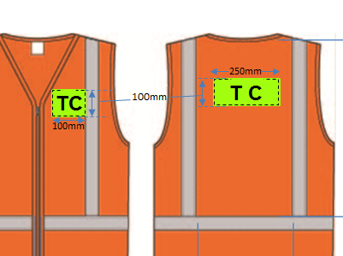
CoPTTM Section B3 High visibility garments
Traffic Controller Reversible Panel Concept
Designed to enable a Traffic Controller to always have it at hand – to be “available” at short notice.
The TC Garment:
A standard orange high visibility garment (Class F or NF)
“TC” panel Front and back
Reversible Panel:
“TC” panel front
Garment orange on reverse

Slide 14
CoPTTM Section B3 High visibility garments
Traffic Controller – TC
Reversible panel concept
Reversible TC Panel:
Front – Yellow Green retroreflective with black TC
Reverse – Garment Orange with Company Logo (Logo optional)
Clear pocket designed to hold TC Panel
Front left panel 100mm x 100mm
Centre back panel 100mm x 250mm
TC
TC
XYZ
ROADS
NZ
XYZ
ROADS
NZ

Slide 15
Thank You Questions
I am keen to have feed back regarding this concept

