Slide 1
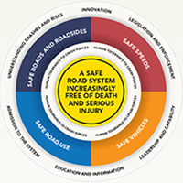


The Safe System Approach
Colin Brodie
Chief Advisor: Safety
NZ Transport Agency
July 2015
: the Safe System in Practice

Slide 2
Presentation outline
International Road Safety scene
New Zealand context
Safer Journeys strategy
The Safe System approach
Watch – ‘The difference between life and death’ video
What this means for traffic management
Notes:
In this presentation I’m going to outline the process we’ve gone through in New Zealand to adopt and embed the Safe System approach.

Slide 3

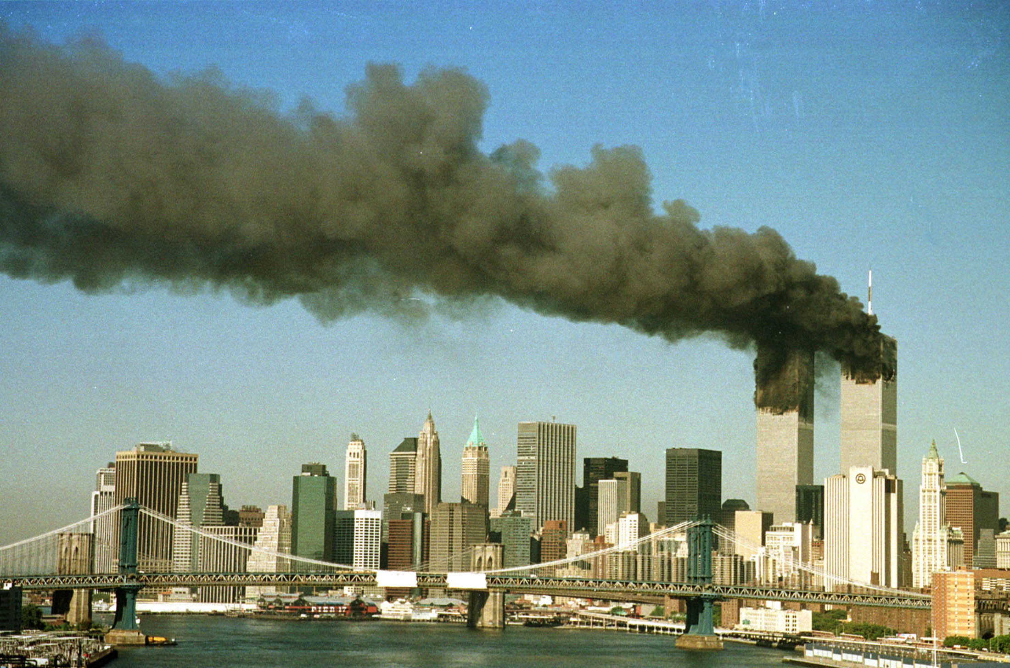
International disasters: New York 9/11
How many died?
2,800

Slide 4
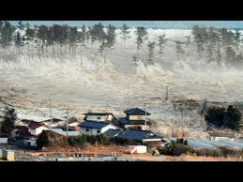
International Disasters:
2011 Japan Earthquake/Tsunami
How many died?
Est > 15,000

Slide 5
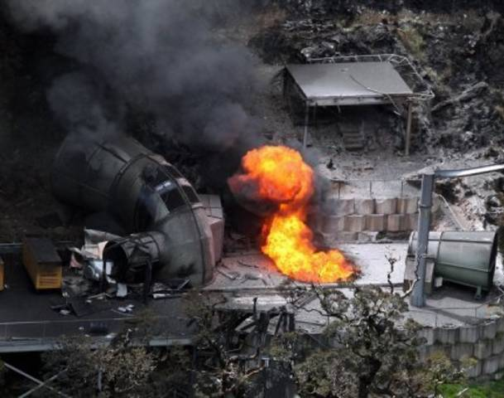
NZ disasters: Pike River Mine
29 Died

Slide 6
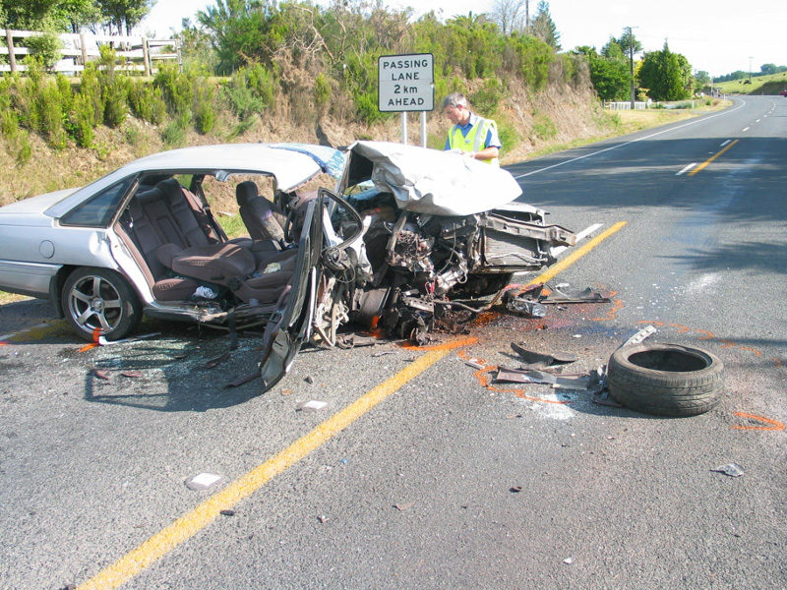
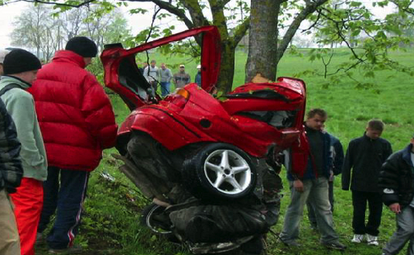
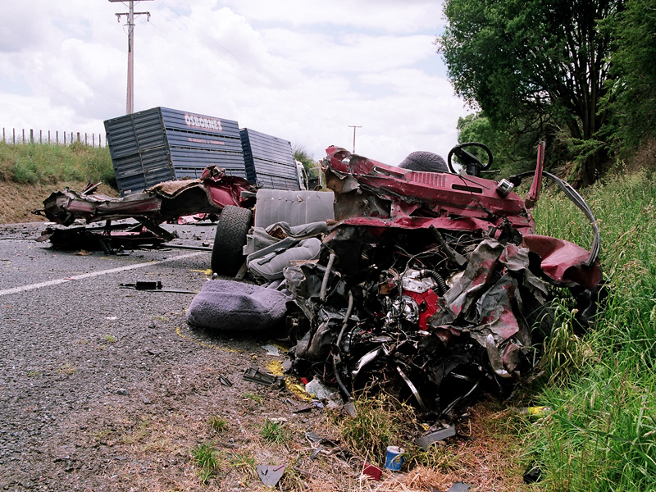
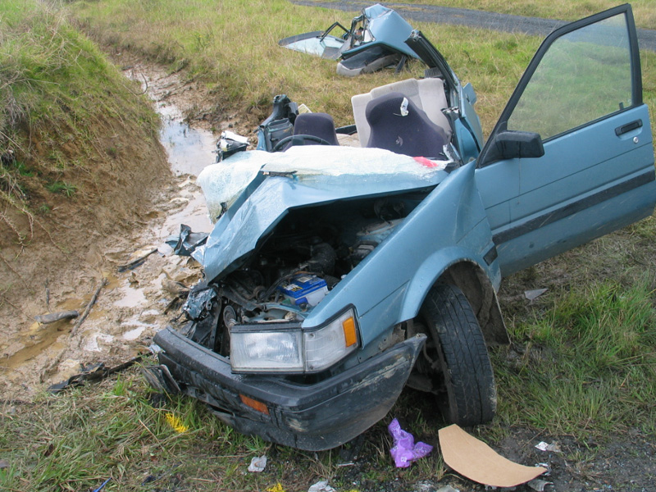
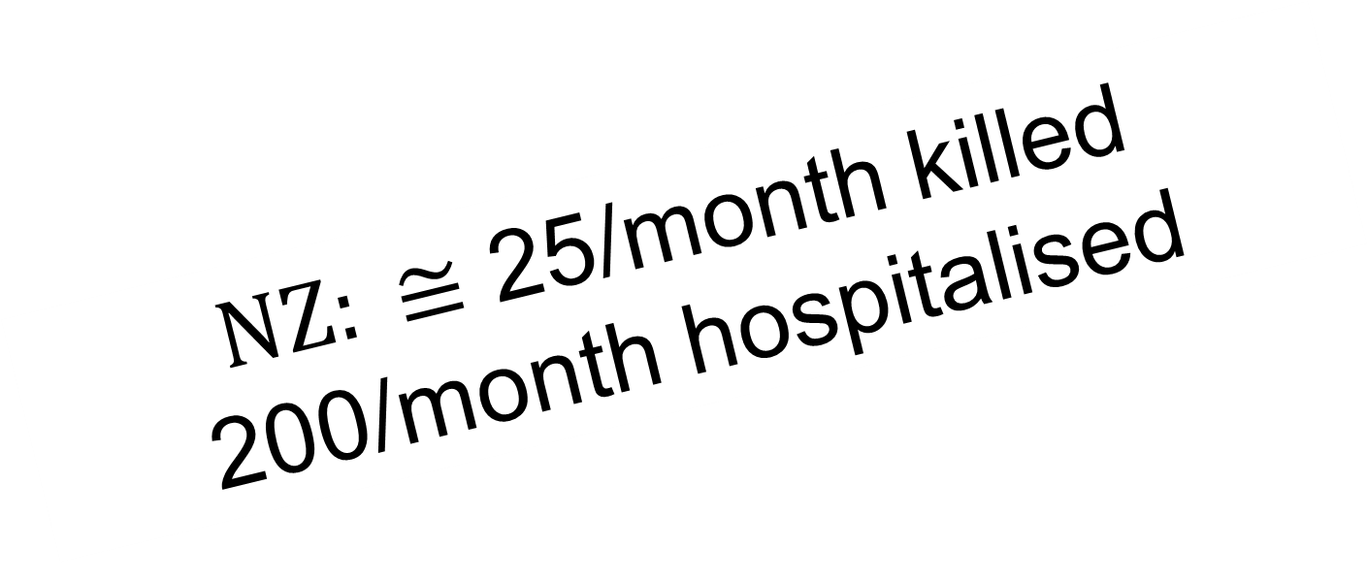
Worldwide road trauma
1.24 million deaths pa
Est 20-50 million injured pa
$NZ: ≅$ 25/month killed
200/month hospitalised

Slide 7

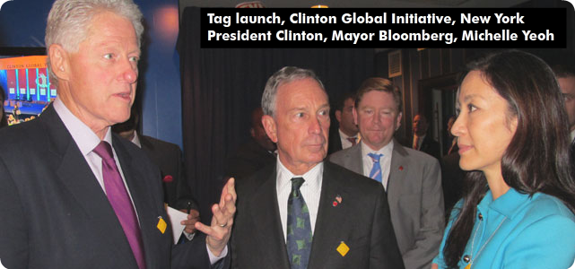

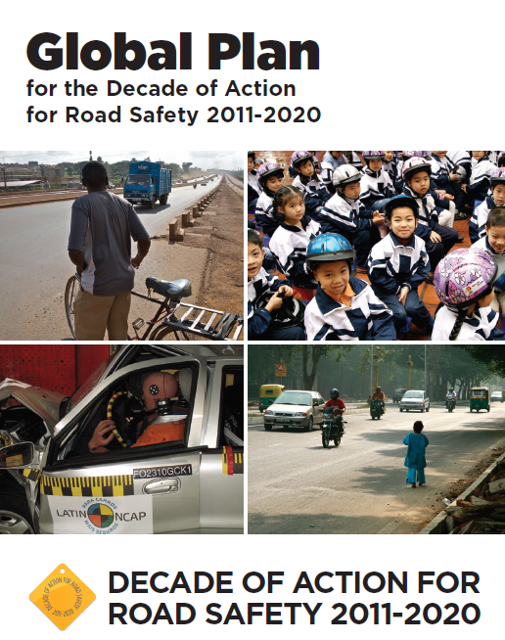
Decade of Action for Road Safety (2011-2020) - United Nations response
Supported by 90+ countries
Coordinated global action
Safe system approach is key

Slide 8
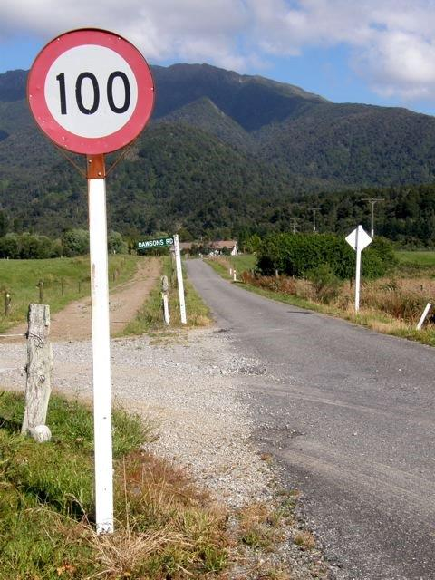
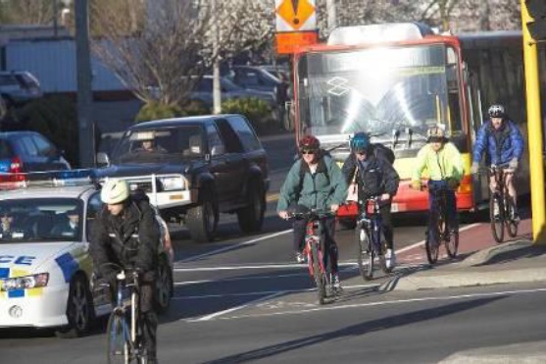
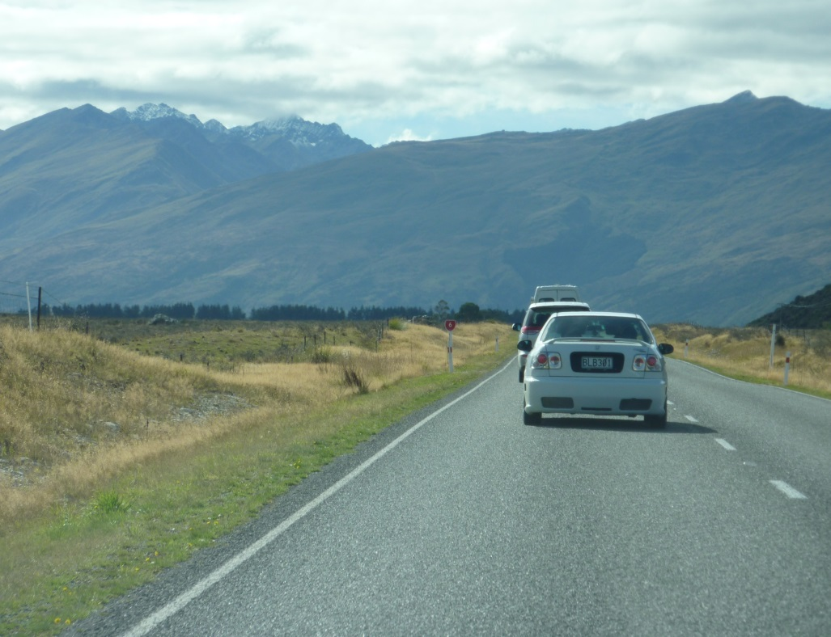
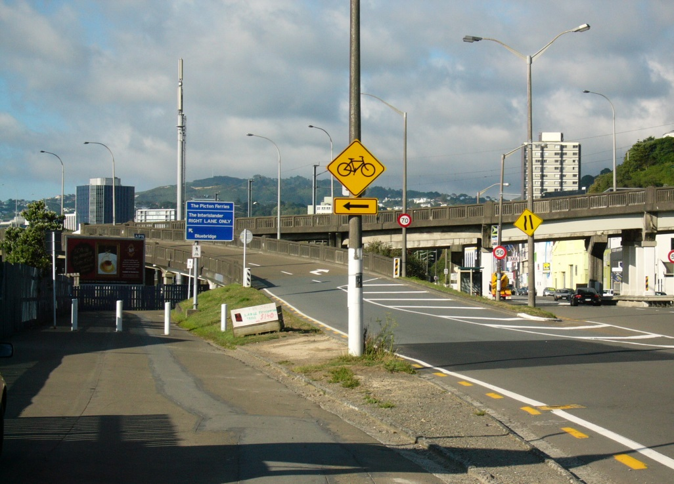
New Zealand context
Notes:
Great progress? Really – another 20,000 people will be killed or seriously injured in the lifetime of Safer Journeys (ie. till 2020).

Slide 9
How do we compare internationally?
Road fatalities per 100,000 population in 2014: NZ = 6.5
: the Safe System in Practice
Notes:
NZ 6.9 in 2012, 5.7 in 2013 (8.6 when Safer Journeys was introduced)

Slide 10
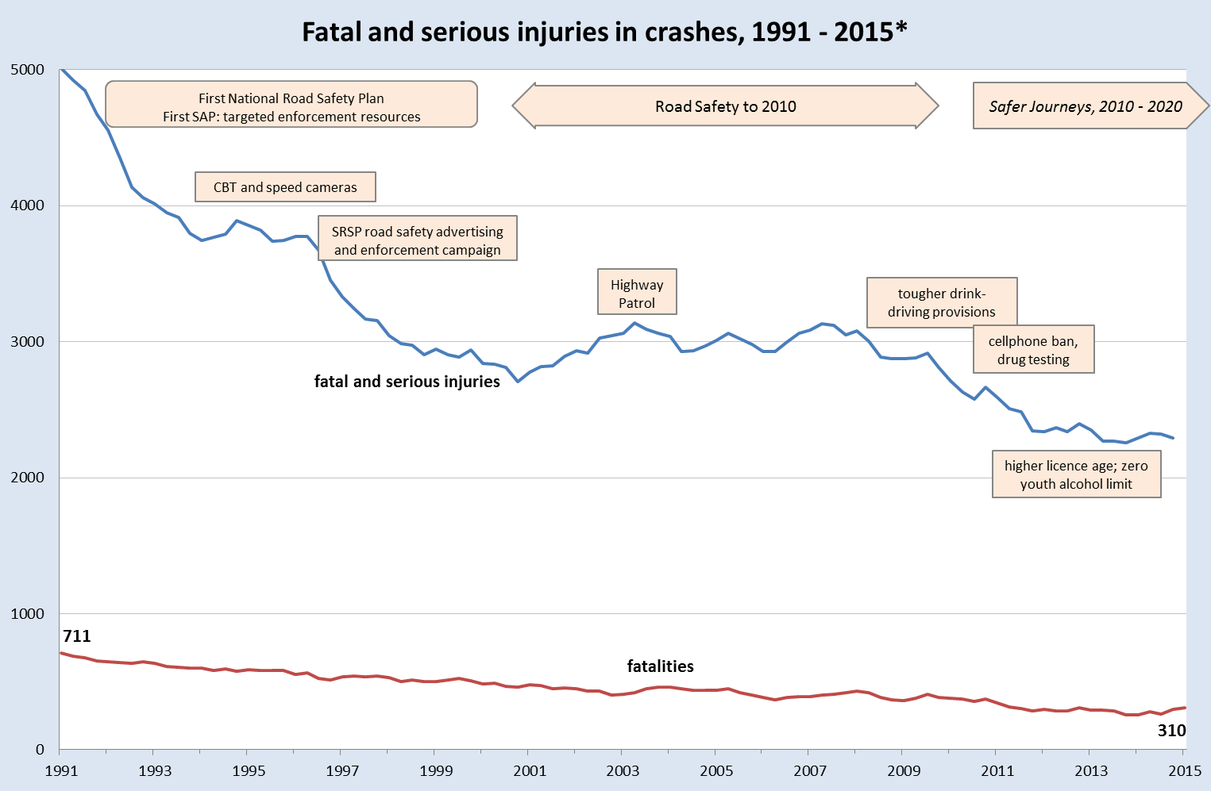
New Zealand road safety performance
Notes:
Great progress? Really – another 20,000 people will be killed or seriously injured in the lifetime of Safer Journeys (ie. till 2020).

Slide 11
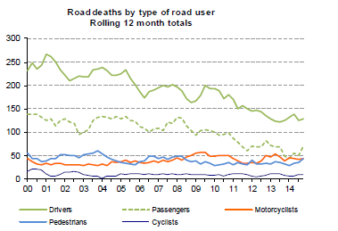
Death Trends by Road User Group 2014
: the Safe System in Practice

Slide 12
Death Trends by Road Type
: the Safe System in Practice

Slide 13

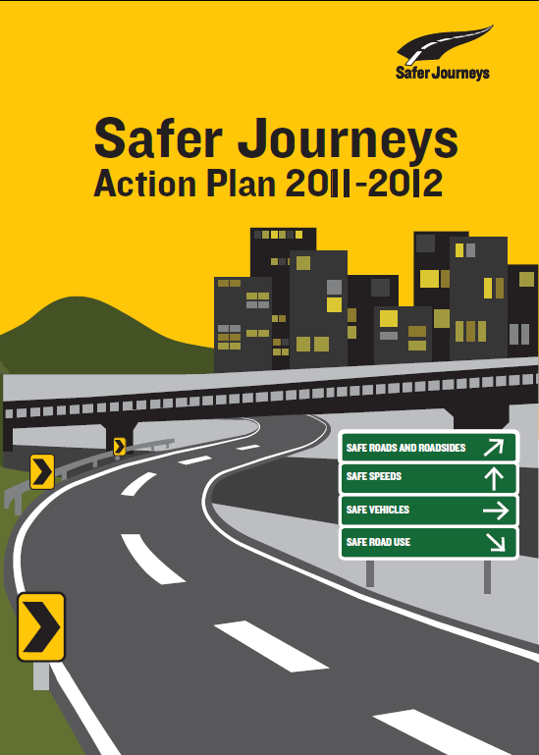
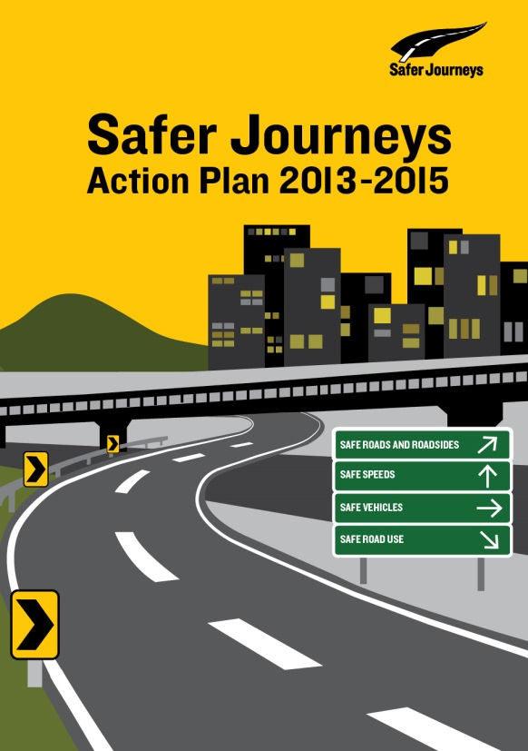
NZ’s Road Safety Strategy 2010-2020
A safe road system increasingly free of death and serious injury
Based on the Safe System Approach
: the Safe System in Practice

Slide 14
The big idea
Create a more forgiving road system that reduces the price we pay
for human error
Why?
Because our current system
is not as safe as it could be

Slide 15
A change in our understanding away from driver blame
Extreme behaviour
Minor illegal
Fatal Crashes
Lapse / error
Wundersitz and Baldock (2011)
http://casr.adelaide.edu.au/publications/list/?id=1231

Slide 16
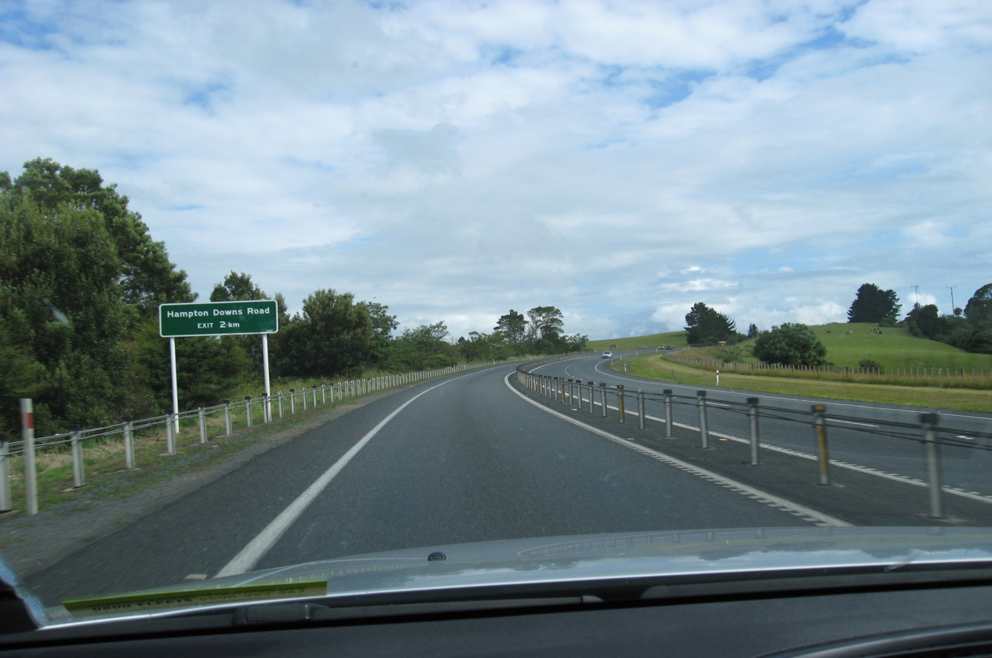
Change the way we think and act!
Errors are inevitable
Crashes are inevitable
Death and serious injury is not

Slide 17
The Safe System approach is based on four principles
1
2
People are fallible
People are vulnerable
3
4
Shared
responsibility
All of system response

Slide 18
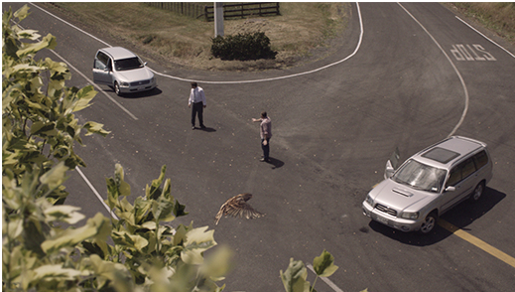
Principle 1 - Human fallibility
People make mistakes and crashes are inevitable
No one performs perfectly 100% of the time
But no one should pay for a mistake with their life or limb

Slide 19
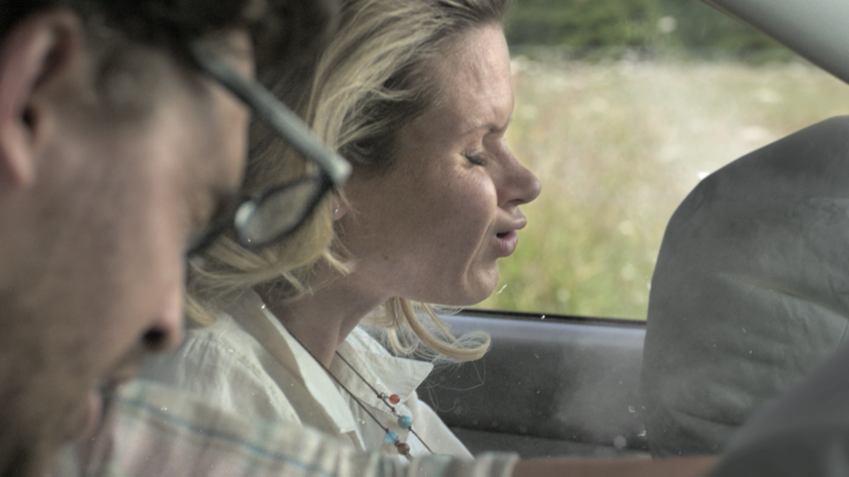
Principle 2 - Human vulnerability
The human body has a limited ability to withstand crash forces
What happens depends on speed at the time of crash and what protection is provided
It’s all a matter of physics: k_{e} = ½mv²

Slide 20
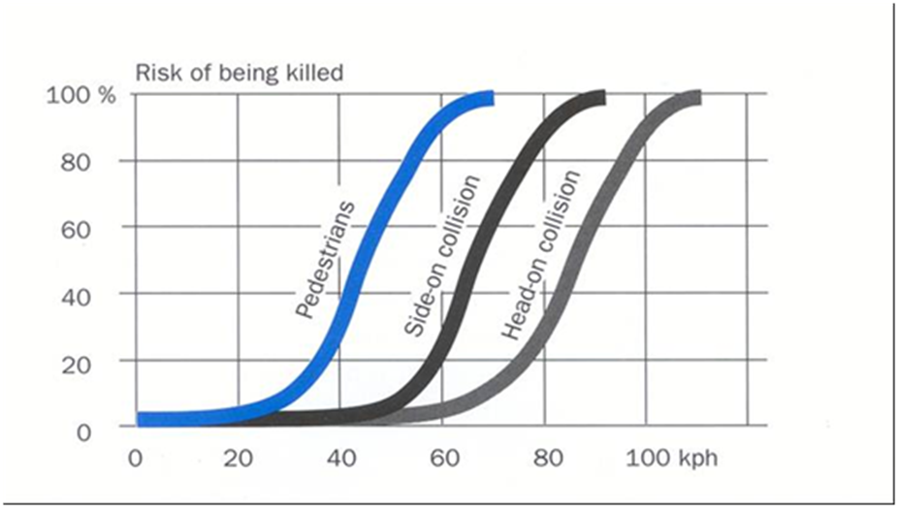
Human survivability

Slide 21
Principle 3: Shared responsibility
  System designers and system users must all share responsibility for managing crash forces to survivable levels
Shared Responsibility
Politicians
Road Contractors
Drivers
Planners
Passengers
Policy makers
System designers
System
users
Engineers
Cyclists
Educators
Utility providers
Motorcyclists
Pedestrians
Enforcers
Retailers
Media

Slide 22
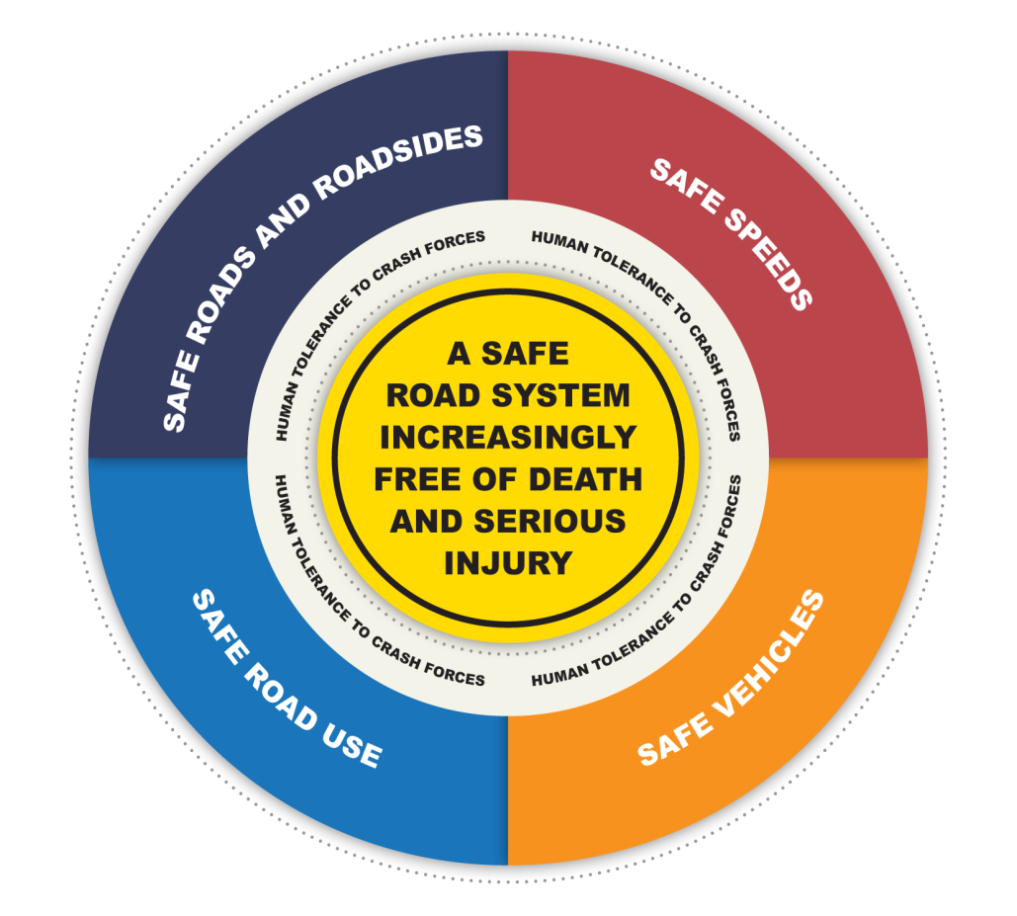
Principle 4 – All of system response
We must improve the performance of all parts of the system
Good performance in one part of the system can help compensate for weaknesses in other parts of the system

Slide 23
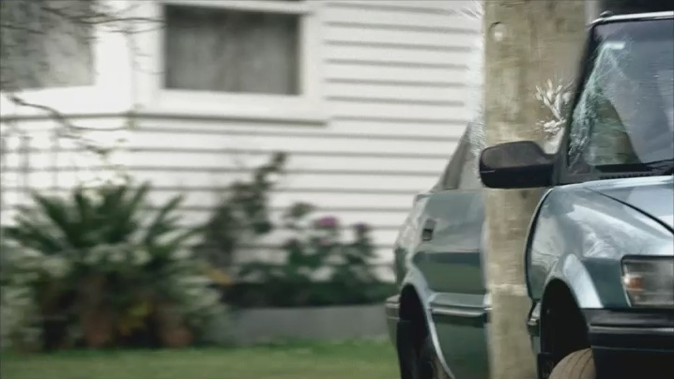
Pole crash example
Historic Approach
That bloody idiot drove too
fast and hit the pole
Safe System Approach
What bloody idiot put that pole there - Safe Roads and Roadsides
Was the skid resistance adequate? - Safe Roads and Roadsides
Did the vehicle have airbags & ESC - Safe Vehicles
Was the speed appropriate for conditions - Safe Speeds
Was the driver aware of the risks, adequately informed and trained – Safe Road Use

Slide 24
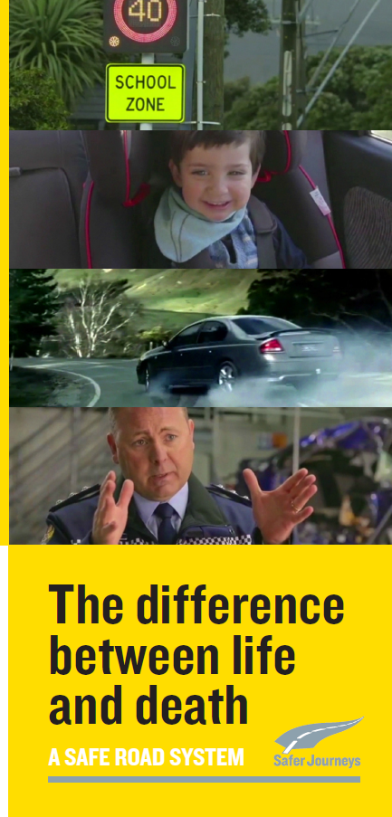
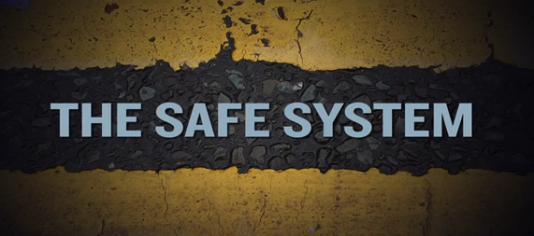
A safe road system is the difference between life and death
www.saferjourneys.govt.nz

Slide 26

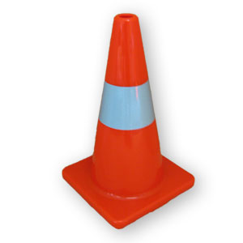
What does this mean in the Temporary Traffic Management context?

Slide 27
System responsibilities for road
safety staff
.
YOU ARE SYSTEM DESIGNERS
.
System Designers are responsible for the design, operation and use of the road system and thus the level of safety in the entire system. Managing crash forces to survivable levels is key goal
I need YOU to think about what this means in your work
Users must be alert, compliant and act responsibly

Slide 28
Let’s look at the risks at road work sites
Significant factor in crash | Number of incidents | Percentage of sample (%)
Speed was a factor | 115 | 65.3
Loose chip, or gravel surfacing was a factor | 92 | 52.3
Site was unattended | 139 | 79.0
There were long-term excavations at the site | 6 | 3.4
TTM equipment was out of position | 13 | 7.4
There were no markings | 55 | 31.3
Queuing and nose to tail incidents | 23 | 13.1
Collisions with road working plant | 7 | 4.0
Public were hit/harmed/at fault | 175 | 99.4
Road workers were hit/harmed | 1 | 0.6
Wet conditions were a factor | 9 | 5.1
A temporary speed limit was in place | 81 | 46.0
Site was on a motorway | 13 | 7.4
Driver was intoxicated | 4 | 2.3
(Representative sample of 176 crashes 2005-12: Resolve Group)
Notes:
Between 2008-2012 there were 1742 worksite crashes
- below are the results of a representative sample

Slide 29
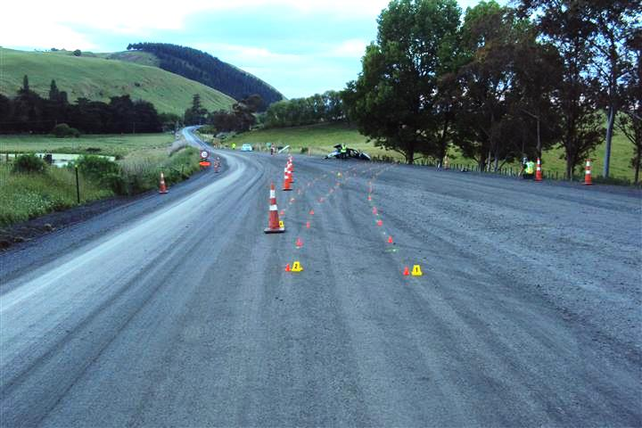
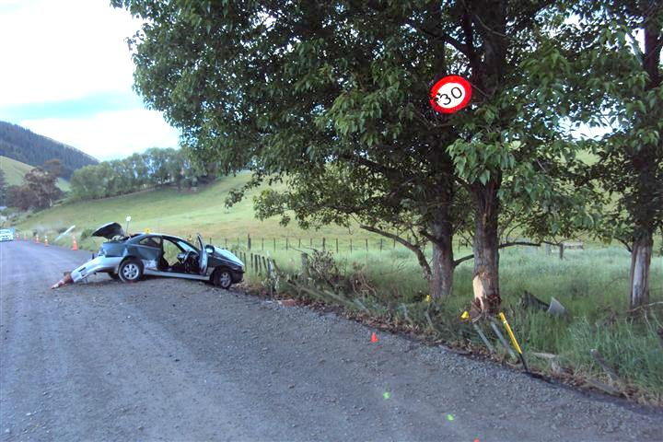
Let’s look at an example
Area wide treatment
and a gravel surface
Driver was speeding
and no safety belt
Notes:
Road accident at sealing site
This crash happened during a sealing operation while the site was unattended at night
The photos are the day after the crash
The driver lost control on the loose surface and hit a tree
The driver died and there were two seriously injured passengers
Speed no safety belt and alcohol were major factors in the crash and its outcome
Even though more delineation may have been required, the crash may not have been prevented
Where we leave an unsealed surface we need to do everything we can to warn approaching motorists
Crane
This crane was parked facing the wrong direction and on the live lane
Police believe that the driver of the car came over the bridge at night and saw the red reflectors. She appears to have driven right into the back of the crane as if she thought she was following a heavy vehicle
Unfortunately we will never know the truth as she died at the scene of her crash
This crane should not have been on the live lane. It is required to be at least 5m away from the live lane and not in any of the safety zones including the taper or on curves or any similar place where they may be struck by an out-of-control vehicle

Slide 30
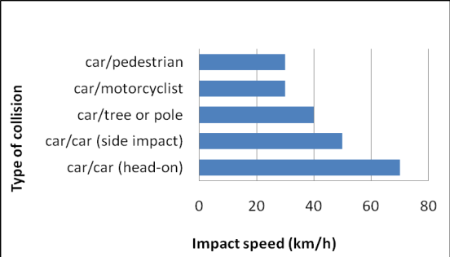
Survivable speeds
Notes:
Road accident at sealing site
This crash happened during a sealing operation while the site was unattended at night
The photos are the day after the crash
The driver lost control on the loose surface and hit a tree
The driver died and there were two seriously injured passengers
Speed no safety belt and alcohol were major factors in the crash and its outcome
Even though more delineation may have been required, the crash may not have been prevented
Where we leave an unsealed surface we need to do everything we can to warn approaching motorists
Crane
This crane was parked facing the wrong direction and on the live lane
Police believe that the driver of the car came over the bridge at night and saw the red reflectors. She appears to have driven right into the back of the crane as if she thought she was following a heavy vehicle
Unfortunately we will never know the truth as she died at the scene of her crash
This crane should not have been on the live lane. It is required to be at least 5m away from the live lane and not in any of the safety zones including the taper or on curves or any similar place where they may be struck by an out-of-control vehicle

Slide 31
Safe System principles
1
2
People make mistakes
People are vulnerable
Yes: Hit tree with forces exceeding human limits
Yes: speed and no seatbelt!
Accept we are human
3
4
We need to share
responsibility
We need to strengthen all parts of system
Did we just rely on the driver obeying the temporary speed limit?
Manage the system
What more could we have done?

Slide 32
All of system response
What is a safe speed for the workers?
What is a safe speed for surface?
What is the safe speed for roadside hazards?
How do we pro-actively manage speed?
Loose gravel
Obstacle protection
  equipment
  roadsides
How do we better advise motorists of the risk?
How do we encourage the right behaviours through positive measures?
Electronic Stability Control.
Encourage use of the safest vehicles possible.
How do we use vehicles to ensure seat belt use, manage speeds and no alcohol?
Notes:
Road accident at sealing site
This crash happened during a sealing operation while the site was unattended at night
The photos are the day after the crash
The driver lost control on the loose surface and hit a tree
The driver died and there were two seriously injured passengers
Speed no safety belt and alcohol were major factors in the crash and its outcome
Even though more delineation may have been required, the crash may not have been prevented
Where we leave an unsealed surface we need to do everything we can to warn approaching motorists
Crane
This crane was parked facing the wrong direction and on the live lane
Police believe that the driver of the car came over the bridge at night and saw the red reflectors. She appears to have driven right into the back of the crane as if she thought she was following a heavy vehicle
Unfortunately we will never know the truth as she died at the scene of her crash
This crane should not have been on the live lane. It is required to be at least 5m away from the live lane and not in any of the safety zones including the taper or on curves or any similar place where they may be struck by an out-of-control vehicle

Slide 33
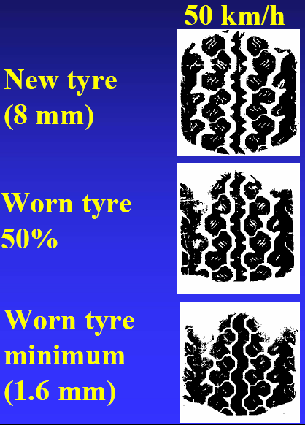
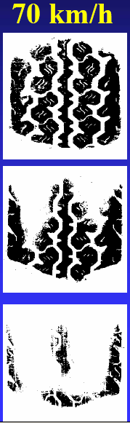
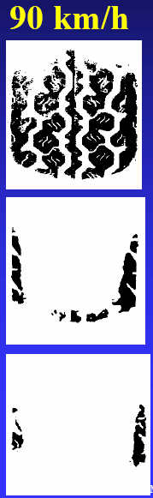
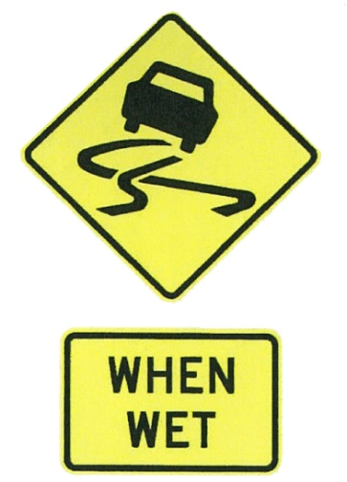
Keeping rubber on the road: tyre footprint with 1mm water depth
New tyre
(8mm)
Worn tyre
50%
Worn tyre
Minimum (1.6mm)
Notes:
Speed and water depth are key elements in skid resistance.
Look at the effect of the amount of rubber touching the road as the tread depth decreases and speed increases on a road with 1mm water.
A near bald tyre at 90km/h has almost no rubber touching the road.

Slide 34
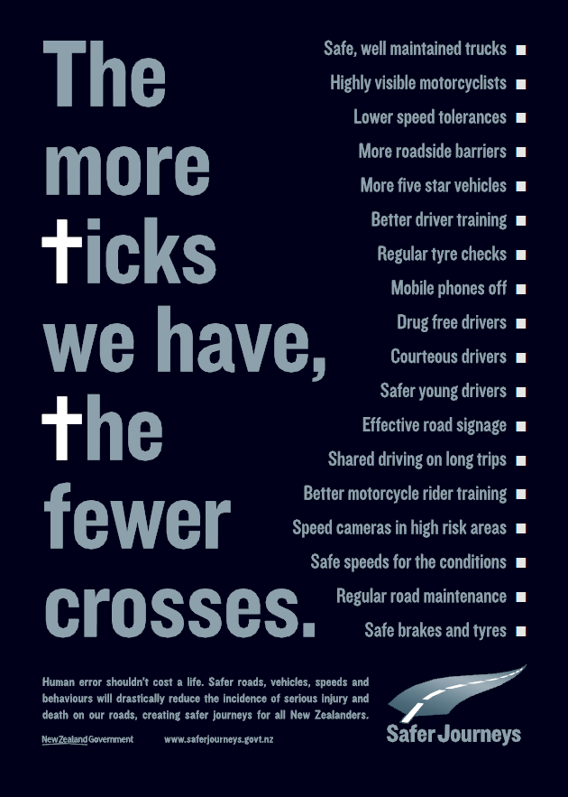
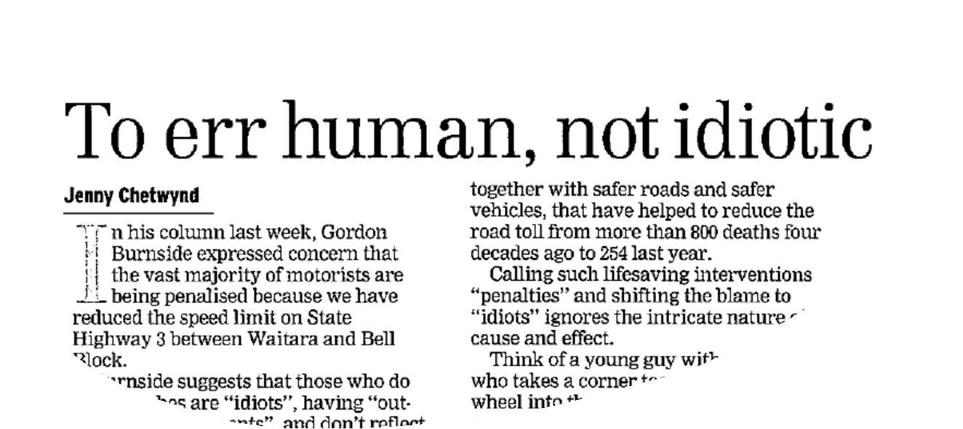
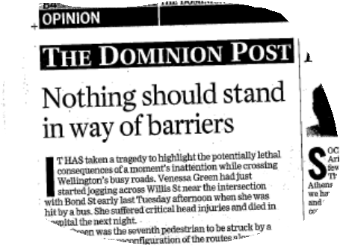
We need to change the road safety conversation
Ask what contributed to the casualty
(not just what caused the crash)
Look beyond the driver;
casualties are system failures

Slide 35

The End
What role can you play in developing a Safe System
Thank You

