Slide 1
TTM Conference 2018
Using Traffic Data to Inform Selection of TTM Methodology
Presented by:
Ben Burrowes
MEngSt (Transportation), CPEng, _{CMEngNZ}

Slide 2
Discussion focus
The value of traffic data
What do we want to know from the data?
Lane Capacity
TTM Methodology
What are we aiming to achieve?
TTM Data Integration App Development
Notes:
What is traffic data and where do we get it?
AADT
SCATS counts
Smart Motorway data
Telemetry Sites
Tube counters
Manual Counts

Slide 3
Traffic Data - Value
AADT
Readily available from RCA
Limited information
Usually no peak flow rates or times
Can lead to conservative choices or working hours
Notes:
- AADT is the most basic form of traffic data but it doesn’t tell us much * No info on peak times or flows. * Can make assumptions but often leads to conservative solutions / approved working hours
NZTA SH Traffic Volumes booklet, AT spreadsheet etc

Slide 4
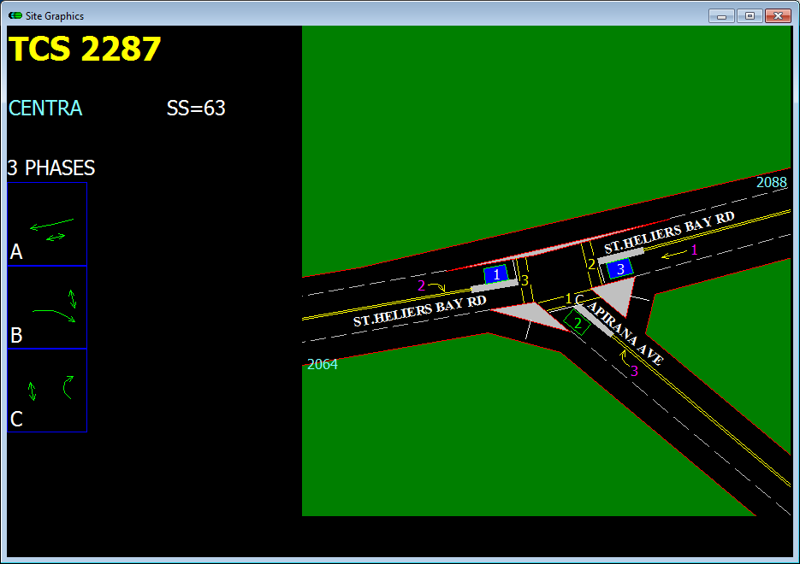
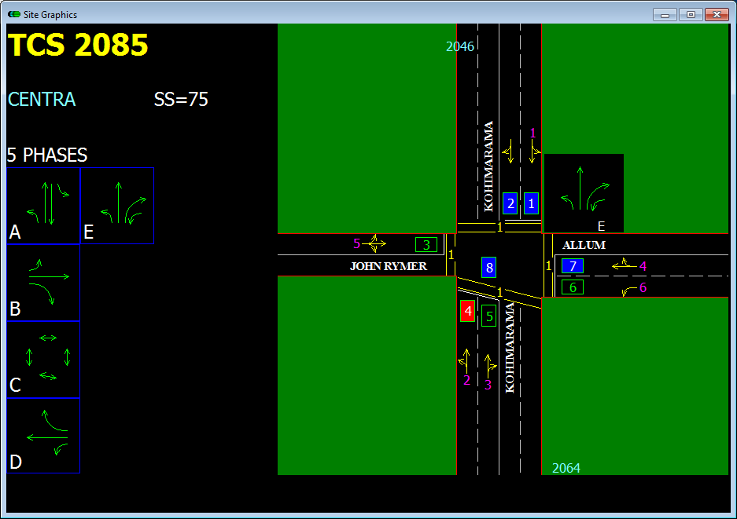
Traffic Data - Value
SCATS Data & Smart Motorways
Available on request
Detailed information (15 min counts)
Requires some processing before use
By lane not by movement
Notes:
SCATS counts come from the traffic signal system
Available from TMCscats@nzta.govt.nz for Auckland counts

Slide 5
Traffic Data - Value
Telemetry Sites
Readily available on NZTA website
Good information (hourly counts % HCV)
Continuous data
Comes Pre-analysed
Limited number of sites
Notes:
https://www.nzta.govt.nz/assets/resources/state-highway-traffic-volumes/docs/2012-2016-national-telemetry-site-profiles.pdf
https://www.nzta.govt.nz/assets/resources/state-highway-professional-services-contract-proforma-manual/psg/psg07-traffic-monitoring.pdf

Slide 6
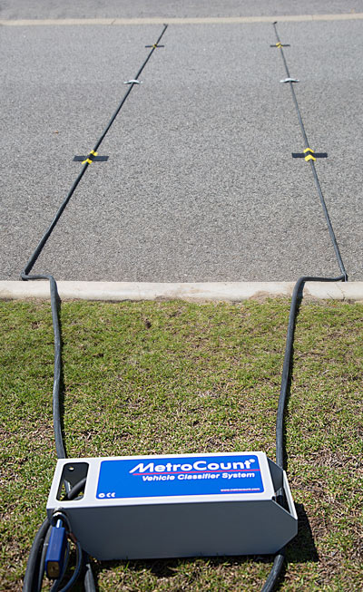
Traffic Data - Value
Tube Counters
Data available on from RCA
Good information (hourly counts % HCV)
Continuous data but for a limited period
Limited number of sites on some networks
Can deploy a special count if data not available
Notes:
https://www.nzta.govt.nz/assets/resources/state-highway-traffic-volumes/docs/2012-2016-national-telemetry-site-profiles.pdf
https://www.nzta.govt.nz/assets/resources/state-highway-professional-services-contract-proforma-manual/psg/psg07-traffic-monitoring.pdf

Slide 7
Traffic Data - Value
Manual Counts
Can be more accurate but not necessarily
Generally limited duration
Labour intensive (Expensive)
Good for filling in holes in data e.g. Split of movements in shared lanes at signals

Slide 8
What do we want to know from the data?
Peak times and flow rates
Traffic Patterns
Is it tidal?
Does it build up quickly to peak?
Does it drop of sharply?
Quiet periods
Hours
Days
Times of year

Slide 9
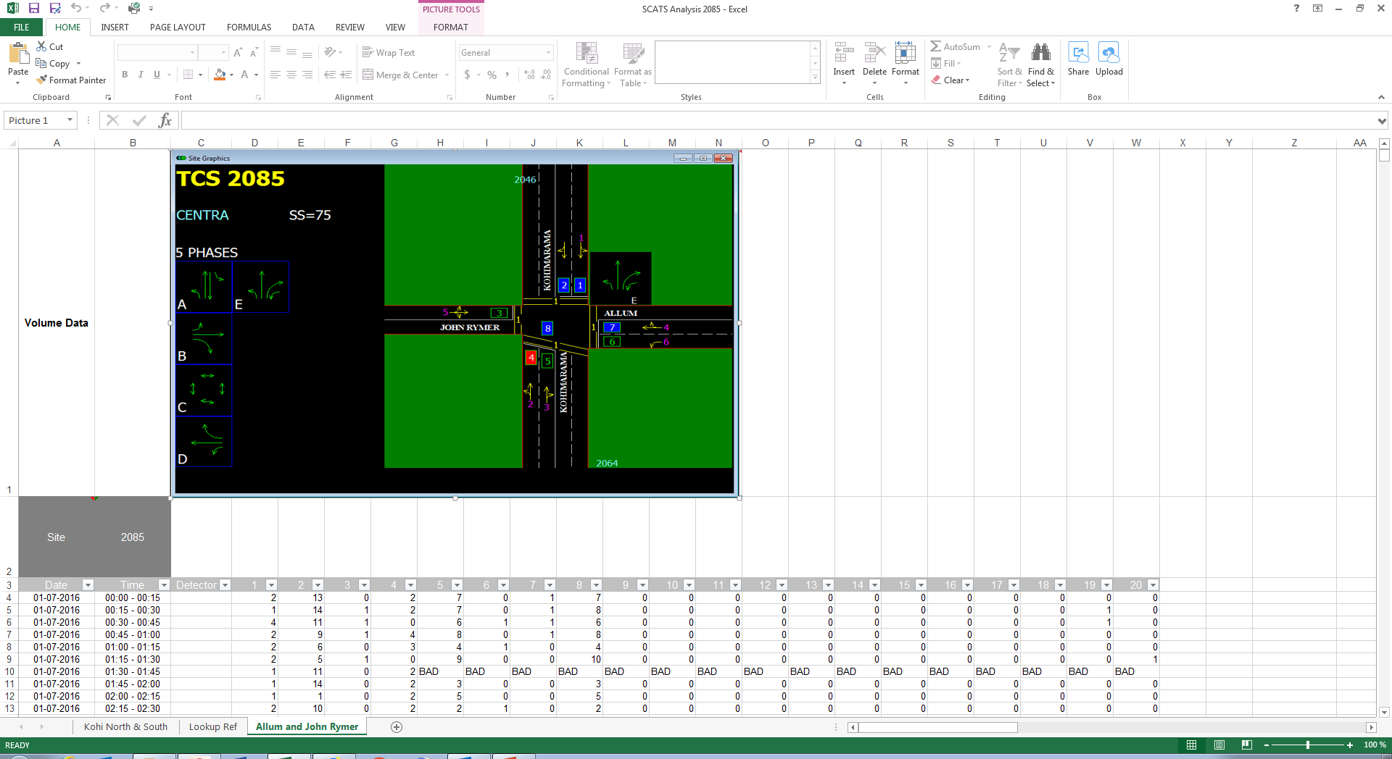
What do we want to know from the data?
Example Analysis
Notes:
Example of SCATS data for an intersection:
BAD = rejected by SCATS system before sending out to me OR unrealistically high numbers (eg 3000 vehicles per 15 min)

Slide 10
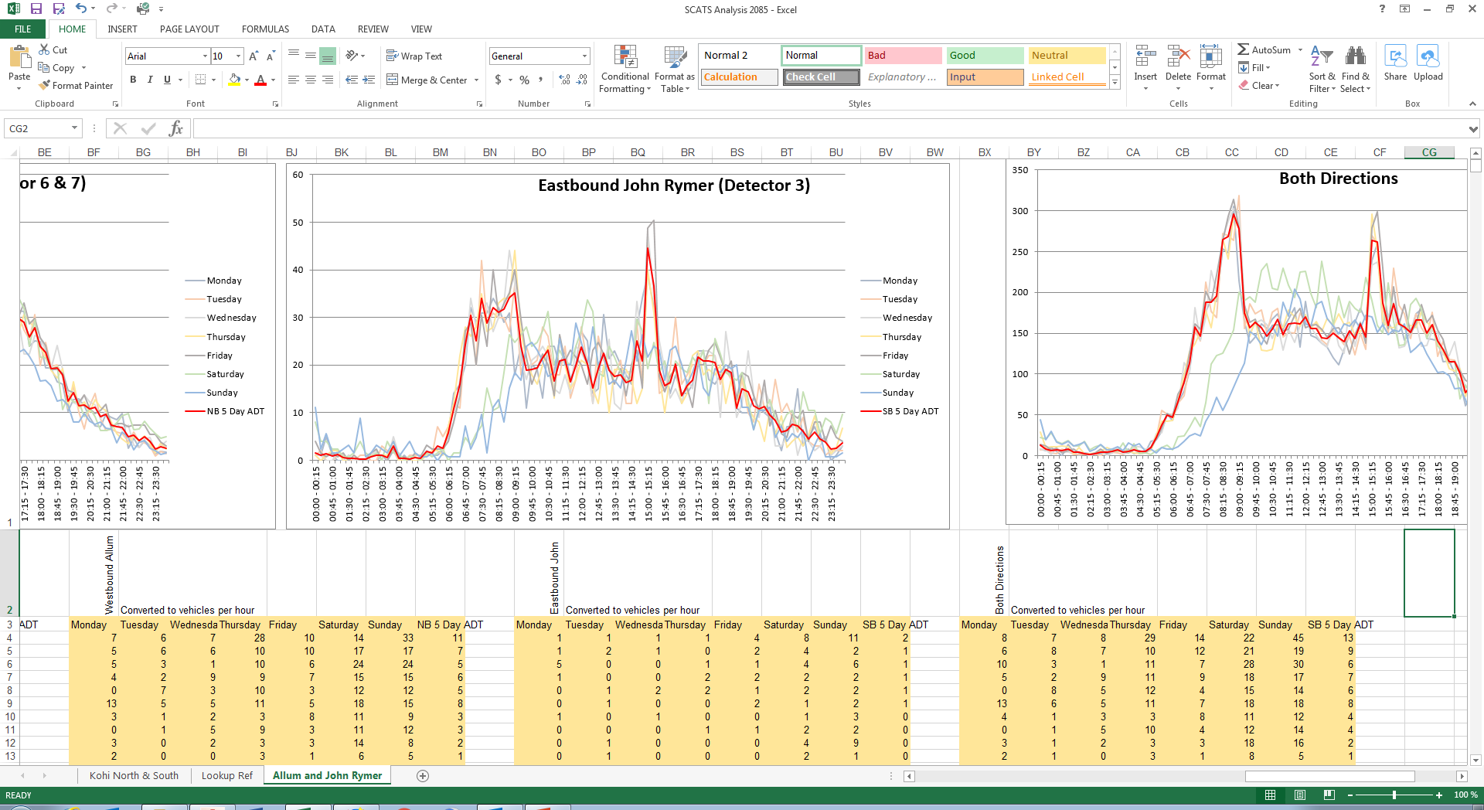
What do we want to know from the data?
Example Analysis
Notes:
Example of processed data. Note: Shows trends throughout the day and for different days but does not currently show variance within sample period.

Slide 11
Lane Capacity
2 lane, 2 way road = 1700 vph per direction / 3200 vph total (HCM 2010)
Not generally achieved but roads can “over perform”
Alternating flow = approx. 1000 vph should be calculated for each site
Capacity can be reduced by:
Lane widths
Narrow shoulders
Side friction
Access points
Distractions
Notes:
What does this mean? A one way system can carry much more traffic than an alternating flow HCM 2010 page 15-5

Slide 12
Lane Capacity
Example Analysis - Show stop / go calculator output
2 way stop / go, 200m long
4 way stop / go, 100m long
Notes:
Example of processed data. Note: Shows trends throughout the day and for different days but does not currently show variance within sample period.

Slide 13
Lane Capacity
Example Analysis - Show stop / go calculator output
6 way stop / go, 500m long
Notes:
Example of processed data. Note: Shows trends throughout the day and for different days but does not currently show variance within sample period.

Slide 14
Lane Capacity
Example Analysis - Show stop / go calculator output
6 way stop / go, 500m long 09:00 – 15:00
Notes:
Example of processed data. Note: Shows trends throughout the day and for different days but does not currently show variance within sample period.

Slide 15
TTM Methodology
Lane closures
Lane diversions / contraflow
Alternating flow
One way systems
Full closure
Peak lane systems
Partial early implementation

Slide 16
TTM Methodology
Lane Closures / Lane Diversion / Contraflow
Maintain both directions
Reduce capacity
Can be ok through peak if number of lanes in peak direction is maintained
Often limits working space (not suitable for some tasks)
Alternating Flow
Maintain both directions
Significantly reduce capacity
Not suitable for peak times or on busy roads
Good working space, suitable for most tasks

Slide 17
TTM Methodology
Full closures
Detours all traffic
No capacity – Detour route length and capacity needs to be checked
Excellent working space
Rarely permissible at peak times
One way systems
Maintain one direction
Near full lane capacity in one direction
No capacity in other direction– Detour route length and capacity needs to be checked
Can be suitable for peak times if traffic pattern is very tidal
Same working space as alternating flow

Slide 18
TTM Methodology
Peak lane systems
What are they?
Reduce number of lanes
Change direction of lanes to accommodate peak flows
E.g.
AM Peak 2 Lanes WB / 1 Lane EB
Off Peak 1 Lane WB / 1 Lane EB
PM Peak 1 Lane WB / 2 Lanes EB
Provides capacity where needed
Allows work to continue during peak time
Labour intensive (cost)
Notes:
3 lanes in a 2+1 configuration
1 lane in a one way system that changes direction

Slide 19
TTM Methodology
Peak lane systems
AM Peak
Daytime off-peak
PM Peak
Night off-peak

Slide 20
Example Site: Remuera Rd

Slide 21
Example Site: Remuera Rd

Slide 22
Example Site: Remuera Rd

Slide 23
What are we aiming to achieve?
Short term vs Long term impact
Delays, Disruption & Capacity vs working hours
Detours cause disruption
Lane restrictions at busy routes / times cause delay
Shorter working hours can significantly extend a job
RCA & Client priorities
Cost
Notes:
We need to think about what we will achieve by convincing the RCA to accept a non-standard solution:
Will an extra hour of working time save a shift?
Is it better

