Slide 2
The Map
What is NCTIR?
Traffic flow on the Alternate Route
NCTIR Work Programme
NCTIR KPIs
Lead Planning for Delay KPI
Lag Monitoring for Delay KPI
Delay KPI Results
Influence of Delay KPI

Slide 3
What is NCTIR?
North Canterbury Transport Infrastructure Recovery alliance:
Over 1700 people inducted
100+ organisations involved
Approx $1.3 Billion budget for repairs
Approx 2 Million person hours delivered to date
Key Milestones reached after Kaikoura Earthquake
SIMT Railway opened for freight 1 Oct 2017
SH 1 reopened (daytime) 15 Dec 2017
SH 1 reopened (night) 30 April 2018
Notes:
NCTIR grew from nothing starting in March 2017 to its peak in October/November 2017
Currently over 2 million person hours across over 100 organisations
Activity is split across bases in Christchurch, Kaikoura, and Clarence

Slide 4
NCTIR – Our Story Video, 6 mins
Optional download of video
W-16 NCTIR

Slide 5
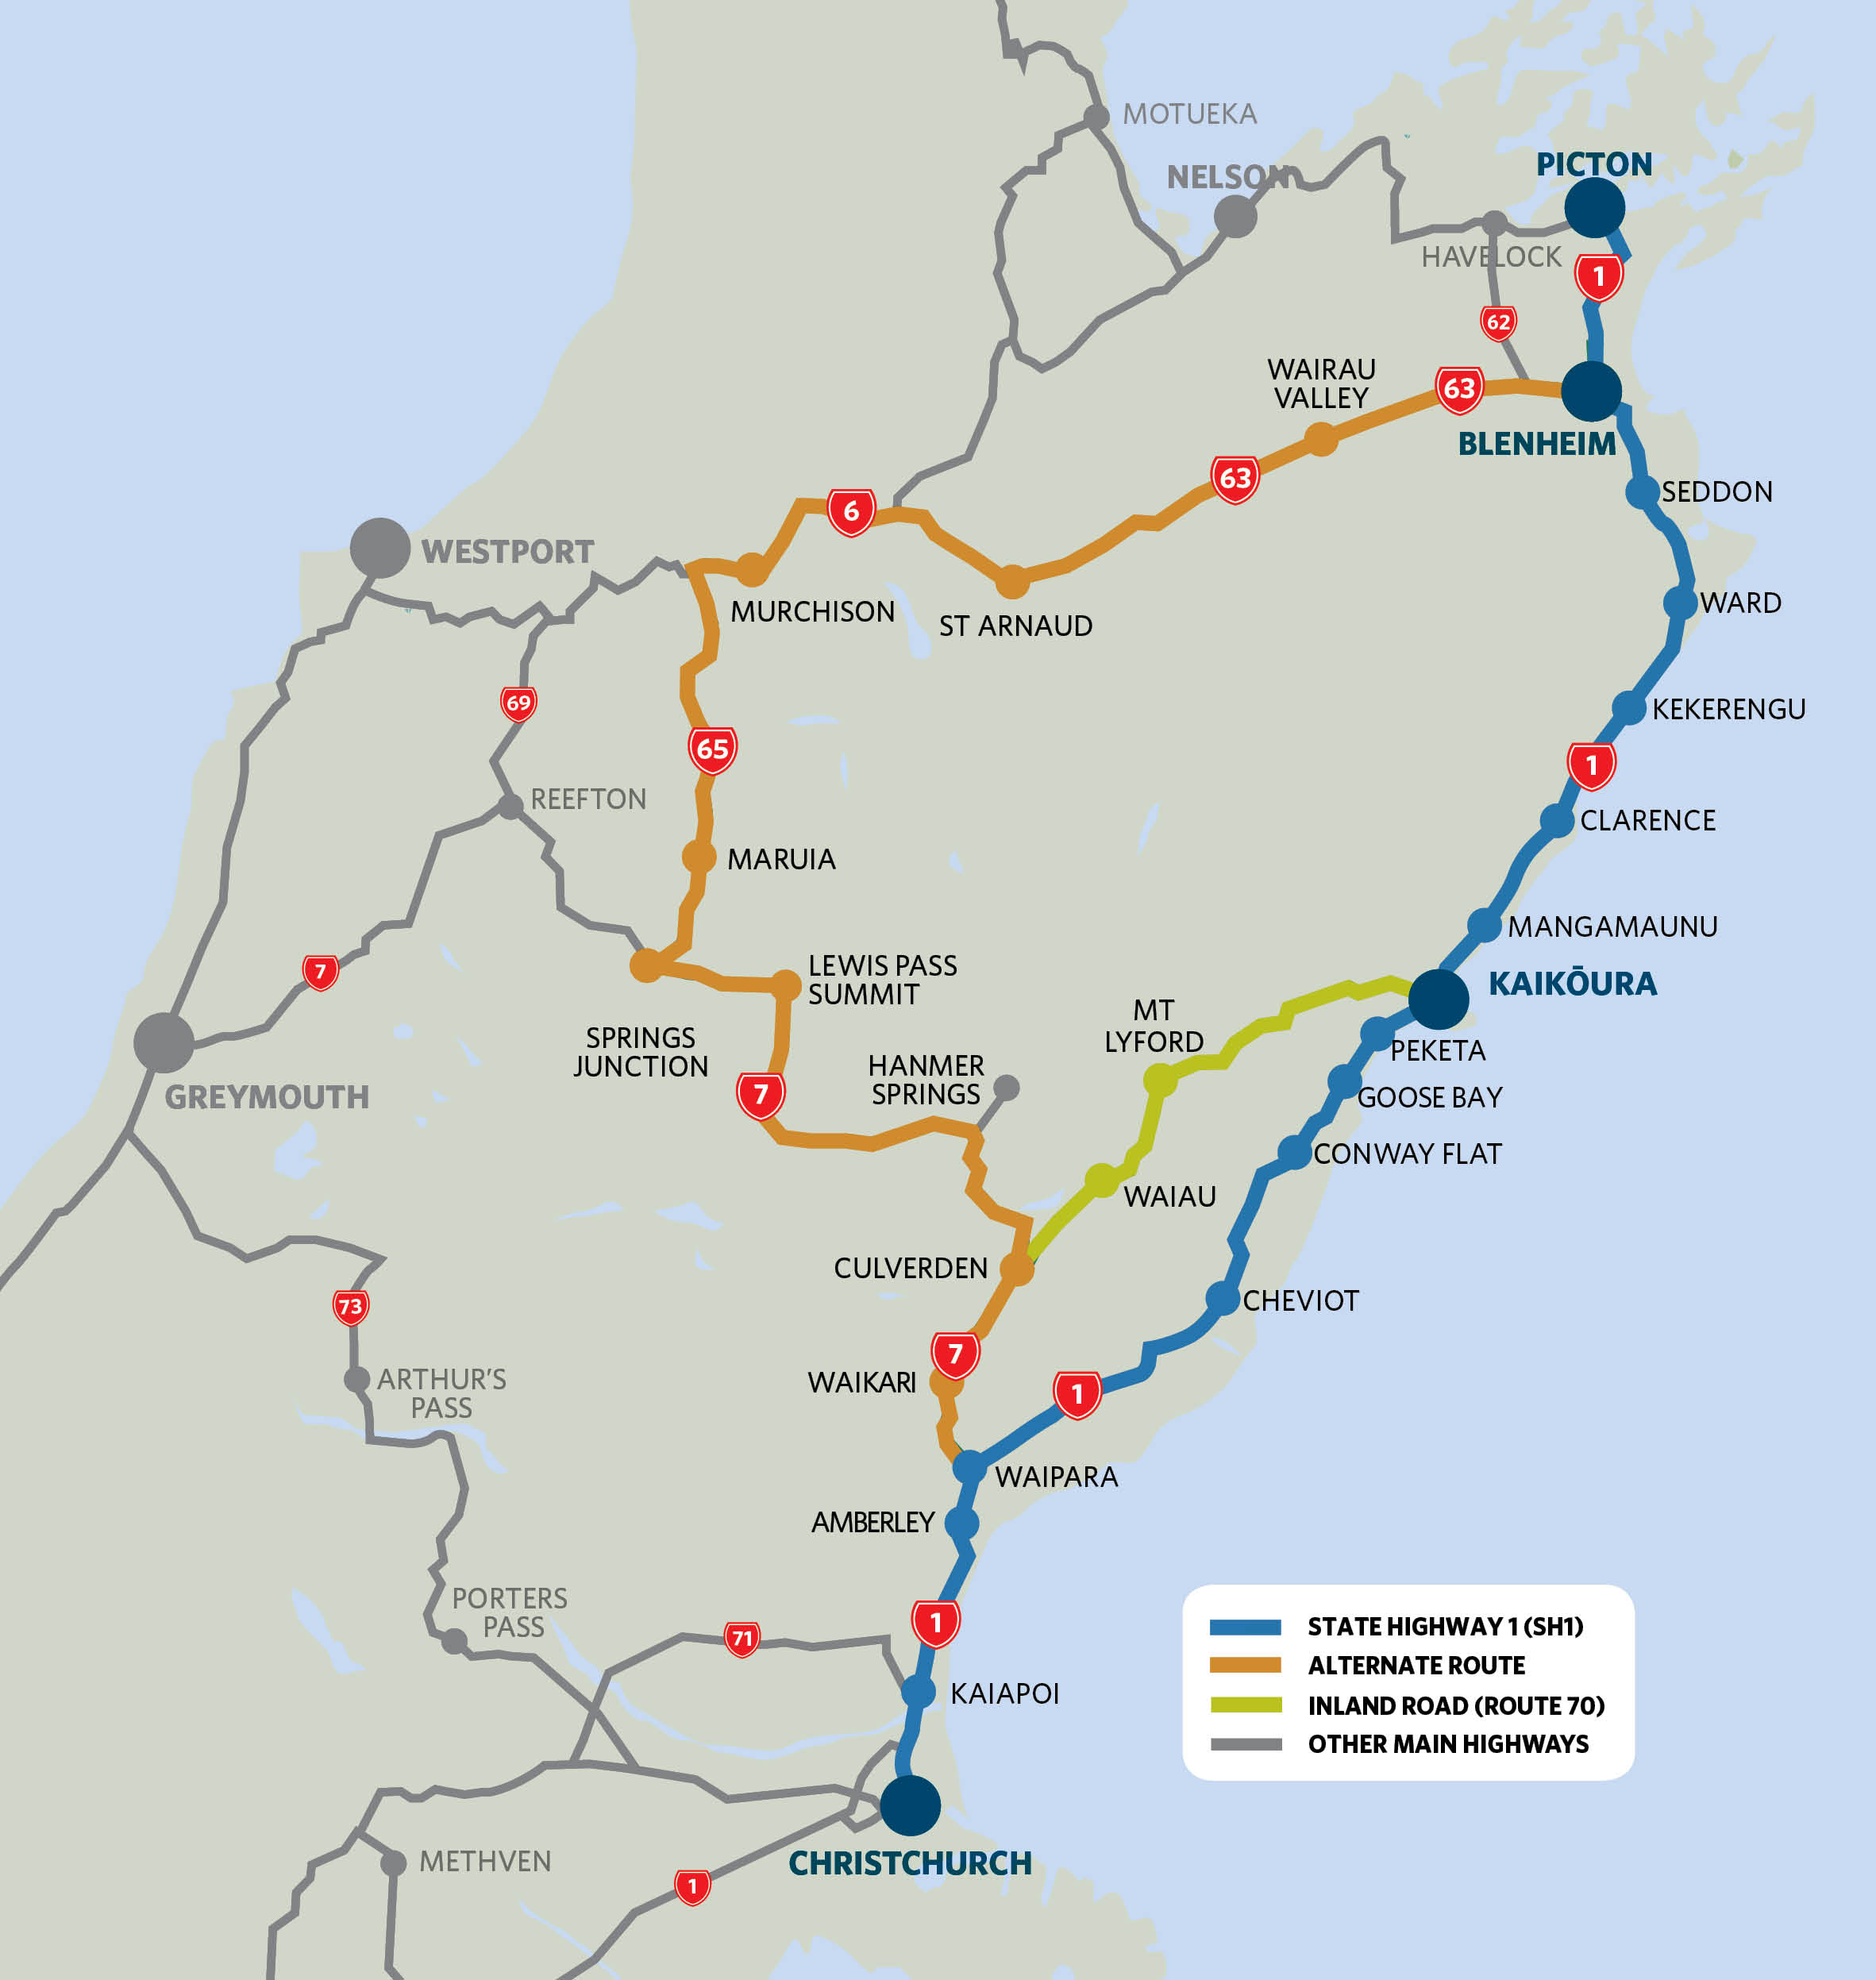
Alternate Route
Marlborough Area repairs
Kaikoura Nth: Road + Rail
Kaikoura Sth: Road + Rail
Inland Route to Kk
Hunderlees Area repairs
Notes:
480km one way trip from Chch to Picton via the Alternate Route
Of which NCTIR were working across the 400km of the Alternate Route - between Waipara and Blenheim
The Inland Kaikoura Route through Mt Lyford was also taken on as an alternative to SH 1 to serve Kaikoura

Slide 6
Traffic Flow: SH 63, Alternate Route
1460% increase
560% increase
Ex SafeRoads Report – 4 May 2018
Notes:
TRAFFIC FLOW on the Alternate Route grew dramatically. Starting in the North:
- SH 63 through St Arnaud saw a Christmas Peak over 6 * flows before Christmas
- Settled to around 4* pervious flows
- The closed SIMT Railway line had its highest impact here with approx. 3500 truck trips per month moved onto the Alternate Route.
- Heavy traffic grew as well to a steady 14 * previous flows!
- At this level the previous Annual flow of HCVs was passing through in every MONTH!!!!
Note the reduction in traffic with SH 1 opening in Dec 2017

Slide 7
Traffic Flow: SH 6, Alternate Route
210% increase
400% increase
Ex SafeRoads Report – 4 May 2018
Notes:
TRAFFIC FLOW moving west through MURCHISON:
- SH 6 saw a Christmas Peak over 5 * flows before Christmas
- Settled to around 1.5 * previous flows
- Heavy traffic grew as well to a steady 2.4 * previous flows!

Slide 8
Traffic Flow: SH 7, Alternate Route
300% increase
220% increase
Ex SafeRoads Report – 4 May 2018
Notes:
TRAFFIC FLOW across the south over LEWIS PASS:
- SH 7 Saw a Christmas Peak over 6 * flows before Christmas
- Settled to around 4* pervious flows
- Heavy traffic grew as well to a steady 3 * previous flows!

Slide 9
NCTIR Work Programme
$60M work programme:
400km across 4 State Highway NOC networks
Programme = 1.5 * normal Annual Regional Works
Summer work programme 2017/18
Peak > 40 stop/go worksites
Vulnerable route:
Only freight route, mid South Island north (to ferry)
Only OD and OW Freight route
Snow and ice through winter
Notes:
To preserve the routes integrity NCTIR picked up a large repair and upgrade programme to match the current route to higher demand
4 State Highway NOC networks make up the Alternate Route, operating under separate Contract Managers and with there own ways of doing things
A challenge to focus Maintenance teams on delivering a massive programme of works (in some sort of co-ordinated way) within the limited summer construction season of 2017/18 began
Only freight link = rail was not operating as SIMT broken through Kk. ALL FREIGHT moving across the Upper South Island now on trucks.
The new route was far more vulnerable to snow and ice during 2017 winter through the ALPINE PASSES ABOVE 860M, than the Coastal Route running close to sea level

Slide 10
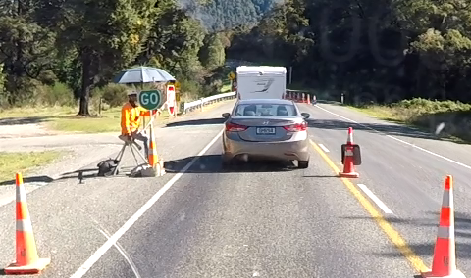
NCTIR KPIs
NCTIR Monitored on 14 KPIs
Delay KPI 2.4 notably:
“Christchurch to Picton Journey Time in FWV measured against actuals.”
NCTIR publicly committed to maximum delay for 2017/18 Summer.
Maximum Delay < 45 mins per trip on Alternate Route
= (Expected trip of 6 hours, incl. a 30 min rest break + Delay)
This is a time critical trip = ferry connection.
Notes:
(For the Alt Route, a delay “free” trip was 6 hours, including a 30 min rest break)
The bulk of trips made along the Kk Coast are leaving from or heading to a ferry sailing at Picton:
7.00am, 12.30noon, 6.00pm, 8.30pm, 11.30pm arrivals in Picton
9.00am, 10.45am, 2.15pm, 6.45pm, 10.15pm departures from Picton
Especially travel to meet a departing ferry is an important trip for freight and tourists.

Slide 11
Lead Planning for Delay KPI : Forward Work Programme (FWP)
The Forward Works Viewer philosophy supports:
Common platform to bring data together
Coordinate physical work activities
Encourage collaboration
Minimise (total) disruption to public
Improved performance of the transport network
Notes:
Although not as spatially complex as the Christchurch EQ rebuild response a similar FWV approach was adopted.
NCTIR built GIS based tools and also focussed on Customer outcomes in its KPIs.

Slide 12
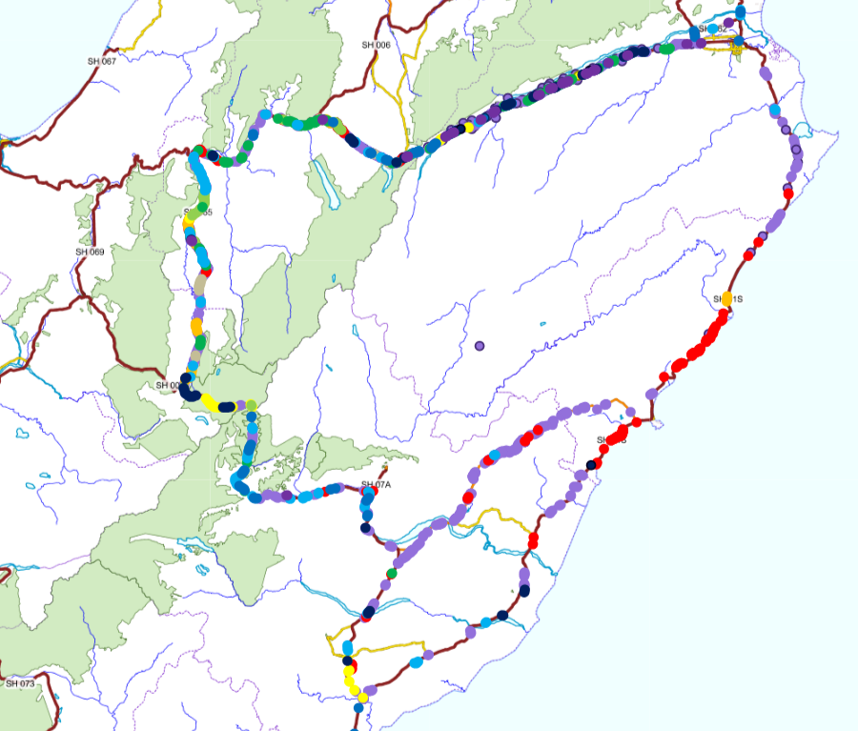
Lead Planning for Delay KPI : FWP
RAMM Forward Works
Making sense of the data …how to manage delay here?
Notes:
Data was pulled into a NCTIR RAMM Database from all 4 NOC networks covered by the Alternate Route
-- RAMM FWD data was useful BUT alone was too complicated and overwhelming

Slide 13
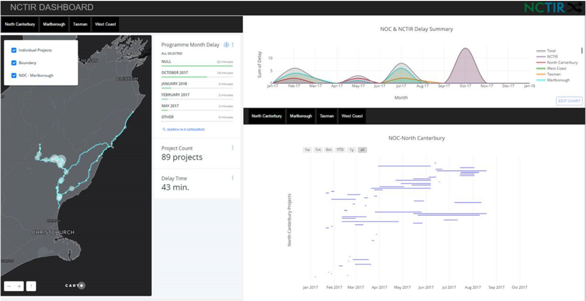
Lead Planning for Delay KPI : FWP
Internal Dashboard from RAMM Forward Works
Accumulated Delay based on combined programmes
Notes:
The accumulated RAMM FWD data was imported into a GIS based tool.
We could identify more clearly here where and when works were planned.
The cumulative graph indicates where the large peaks will occur in time.
This graph shows a massive peak in one contract area is planned in Oct 2017.

Slide 14
Lead Planning for Delay KPI: FWP
Internal Dashboard from RAMM Forward Works
Timeline showing each worksite’s contribution
Notes:
The Gannt type chart shows which specific worksites are active during the high travel delay periods.
This detail gives the opportunity to reschedule in time specific works to BALANCE TOTAL DELAY.

Slide 15
Lead Planning for Delay KPI: FWP
Internal Dashboard from RAMM Forward Works
Spatial mapping of current worksite locations (based on a time slider)
Notes:
The map display is based on a time slider running across the Gannt chart and generating details such as the total Projects active and the current accumulated delay (in each NOC network

Slide 16
Lead Planning for Delay KPI: FWP
Internal Dashboard from RAMM Forward Works
Summary numbers of current worksites, scale of delay, (based on a time slider) – also showing months ahead.
Notes:
Output of site numbers and month ahead programmes allowed a clear overview of work progress.
Taking a regular feed from RAMM data this output is updated and reviewed usually weekly as forward programmes were updated – TO PLAN AHEAD AROUND PEAK DELAY PERIODS.

Slide 17
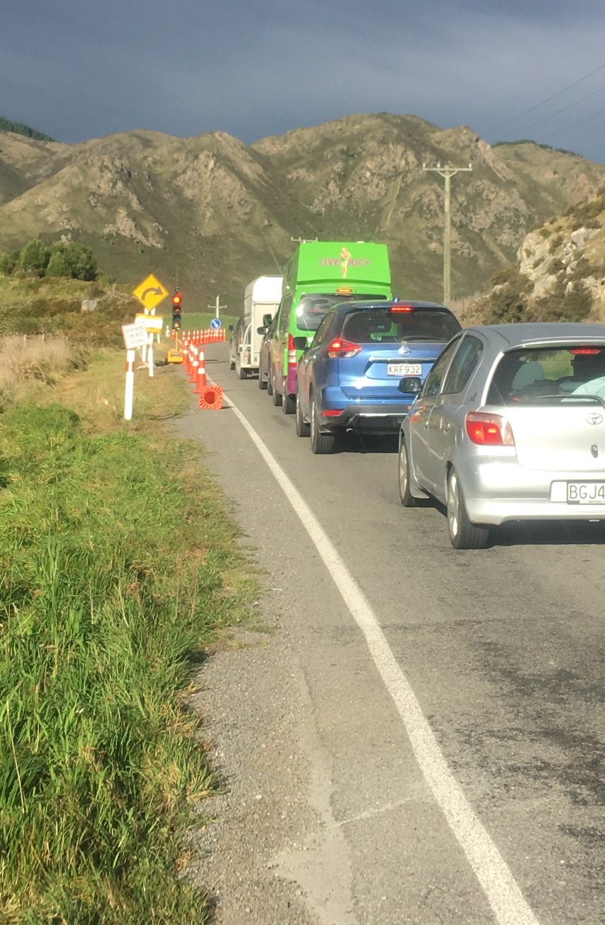
Forward Work Programme Analysis
KPI drove review of combined programme for:
Peaks in delay (to reduce)
Max size of planned peak delay re Delay KPI
Troughs in delay (to increase)
To increase planned delay, within the Delay KPI
Notes:
Peaks in delay (to move planned works away from)
Current programmes took no account of work in adjacent areas so peaks would occur mainly in “best part of construction season”
Moving work in time to reduce peaks – and reduce the risk of delay blowing out over the KPI measure
Troughs in delay (to move planned works towards
Troughs in delay provided an opportunity to move work and still meet the KPI
– OVERALL, LIKE IN ANY ROAD PROJECT, BALANCING DELAY AND PROGRAMME DELIVERY IS A COMPROMISE, AND REQUIRES FOCUSED FORETHOUGHT.

Slide 18
Lag Monitoring for Delay KPI: Reporting
Daily travel time predicted/monitored:
Daily delay from weekly programmes
Actual Peak travel time daily
Actual Average travel time daily
Google travel time data also provided Real Time feedback
(through an NZTA developed console)
Notes:
Each NOC Team (4 off) provided delay estimates daily - based on their individual approved RAMM weekly programmes
Peak daily travel time was derived from Google travel time data – recorded across the day (6.00am to 10,00pm) and supplied daily
Average daily travel time was derived from Google travel time data - again from across the day (6.00am to 10,00pm) supplied daily
Combining these measures together yeilded an accuracy measure for prediction and a comparison against our absolute delay travel time measure.
Google travel time provided in Real Time was also taken into an online tool where CURRENT DELAY CONDITIONS COULD BE MONITORED – if a trend towards peak delays was noted then action could potentially be taken in real time.

Slide 19
Internal Current Travel Time
Alternate Route
Notes:
NZTA developed a Console or viewer of real time Google data.
Data specifically for the Alternate Route:
Current accumulated delay
Delay over the last 15 minutes period to indicate growing trends

Slide 20
Internal Current Travel Time
SH 1 – Coastal Route
Notes:
Also - Data specifically for the SH 1 Coastal Route
-- This tool also allows comparative travel time between the Alternate and Coastal Routes with both open

Slide 21
Internal Current Travel Time
SH 1 – Delays
Notes:
The Console shows in some detail WHERE THE DELAY IS CONCENTRATED:
See major delays at worksites in this North and South of Kk on SH 1 from earlier this week (May 2018).
The colours show the scale of the delay and its location from real time Google travel time data.

Slide 22
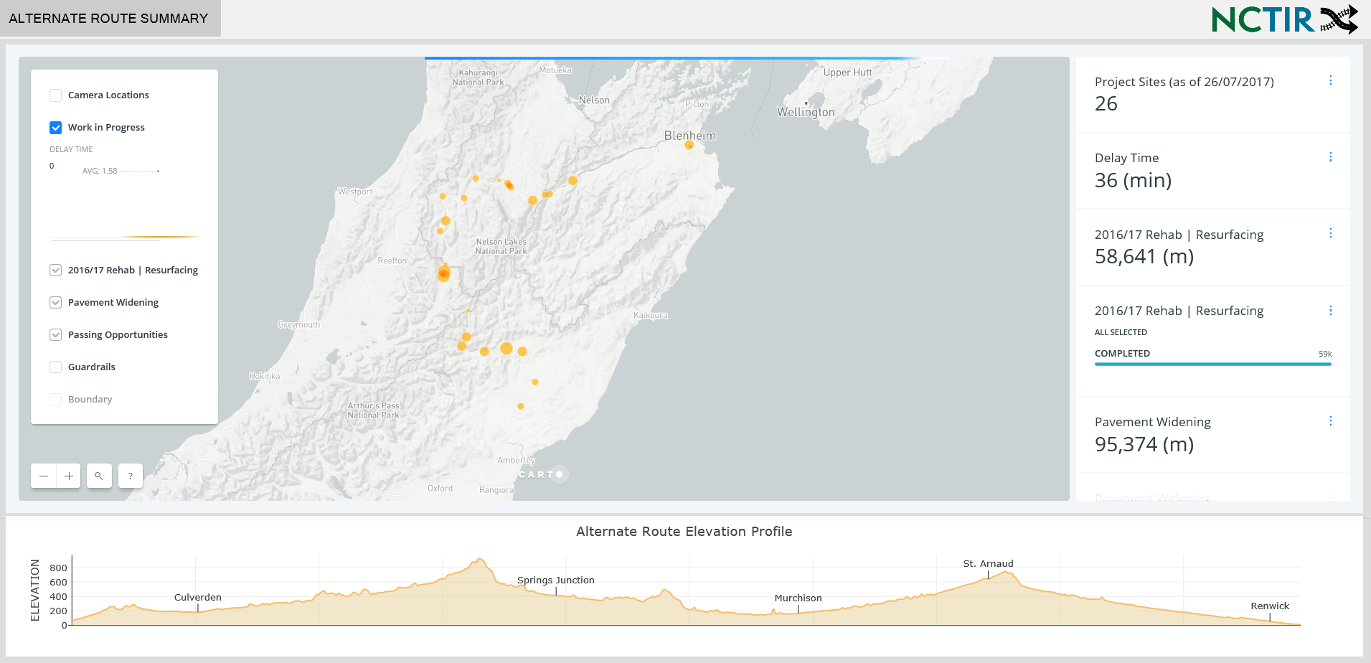
Shared External Information
Current expected delay - today
Notes:
NCTIR also wanted a tool to provide better Public Information regarding Delay.
Wanted to let road users to use it for TRIP PLANNING TODAY.

Slide 23
Shared External Information
Number of current worksites along the route
Notes:
There was also the opportunity to promote progress on the works to date.
Numbers were provided showing the current updated scale of work underway and completed:
Current number of worksites (contributing to delays)
Current work completed as well

Slide 24
Shared External Information
Spatial mapping of current worksite locations
Notes:
For those more visual learners – a map was provided showing where the worksites are located along the whole Alternate Route:
Larger dots show points where there is more major delay

Slide 25
Delay KPI Results
Notes:
The Delay KPI recording as a performance measure indicated:
Actual travel time (blue, red and yellow lines) never fell below the baseline (grey dotted line)
Estimated travel time (black-dotted line) from delay accumulation across the full Alternate Route fell generally between the average and peak delay from real time data
The Average Peak was within 370 minutes travel time
The Absolute Peak travel times however were > 390 minutes. THIS WAS > AN HOUR AND HALF LONGER THAN THE 6 HOUR BASELINE!!!
The very high peaks were incidents such as crashes that causes major delays at one location.

Slide 26
Influence of Delay KPI
Focus onto:
Delay per worksite (1-2 mins each)
Combined delay (40+ worksites)
Worksites not complete on programme
Public acceptance of planned delays
Weekly co-ordination process
Collaboration across 4 Networks (NOCs)!!
Notes:
This KPI discussion and management focused onto:
Acknowledging the delays caused by each worksite
Combined delay and programming of works to manage higher level delay outcomes
Identifying worksites in place beyond their programmed period
Planning and standing by the “Expected Delay” to give travellers confidence in their time of arrival
Bringing together separate NOC Networks to coordinate outcomes and remove peaks

Slide 27
Thanks and Questions
References:
LINZ National Forward Works Viewer (April 2017), Angus Bargh
Safer Roads, Update – Post Kaikoura Re-routing Around the Mid to Top of South island (4/5/2018)
NZ Transport Agency travel time console (Google travel time data)
NCTIR GIS tools (NCTIR dashboards, both internal and external)

Slide 28
Now the focus moves to SH 1 Delay….
James.Park@wsp-opus.co.nz

